Slide 1


Streaming and the next generation of talent
Luke O’Shaughnessy
Opera Europa

Slide 2
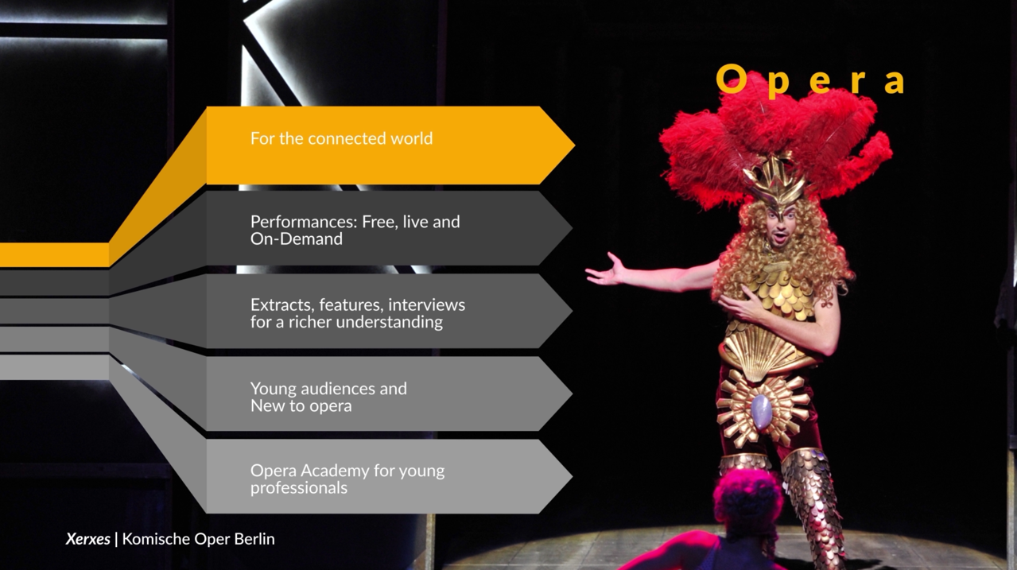

Slide 3
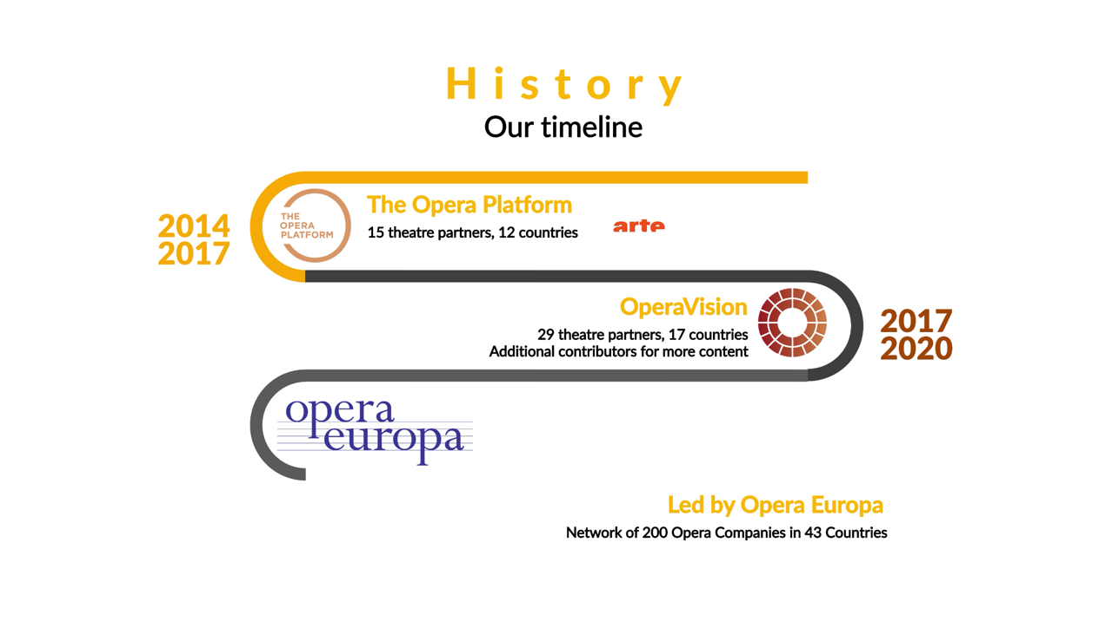
…

Slide 4
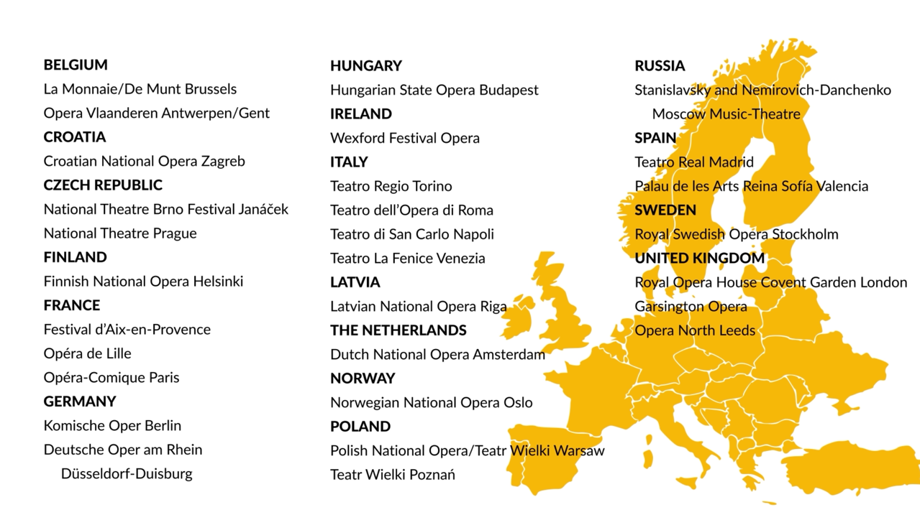

Slide 5
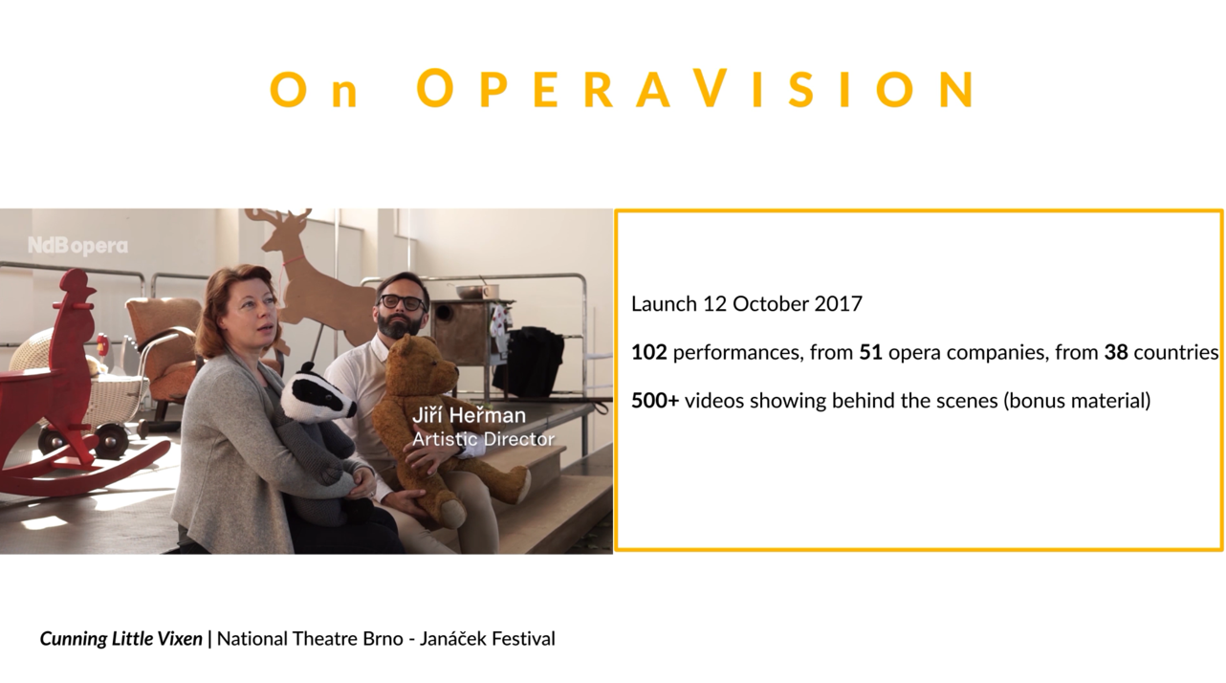
150

Slide 6


25 October 2021 – Young Artists’ Programme

Slide 7

What is happening on 25 October 2021?
10:00 New National Theatre Tokyo
18:00 Dutch National Opera Amsterdam
12:00 Opéra Comique Paris
20:00 Polish National Opera Warsaw
14:00 Royal Opera House Covent Garden
22:00 Teatro Regio Parma at Festival Verdi
& Teatro dell’Opera di Roma
16:00 Staatsoper Hannover

Slide 8
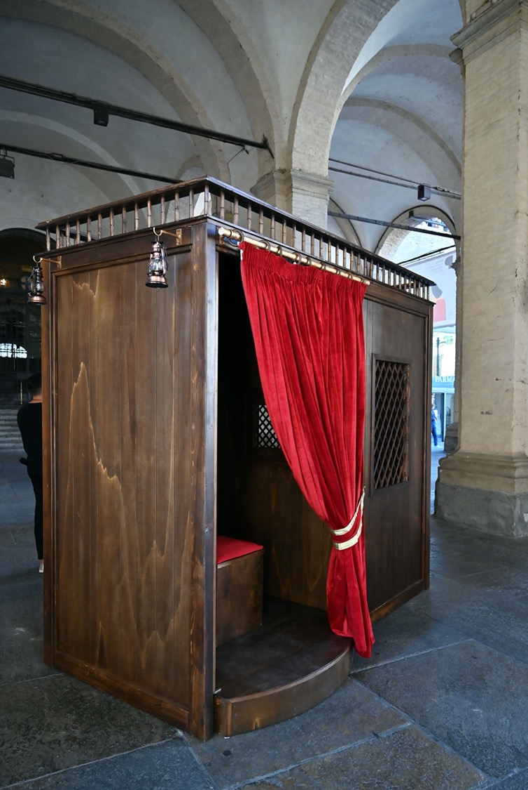
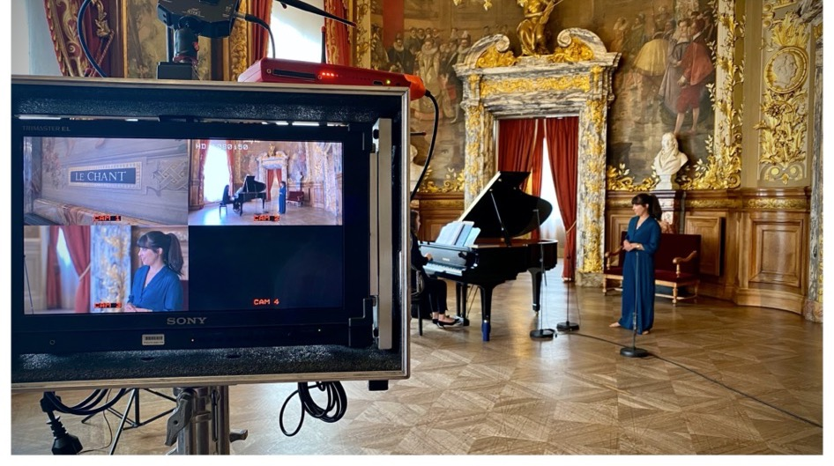
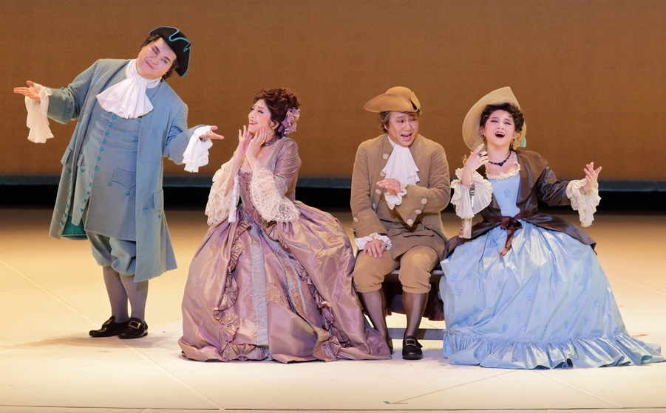
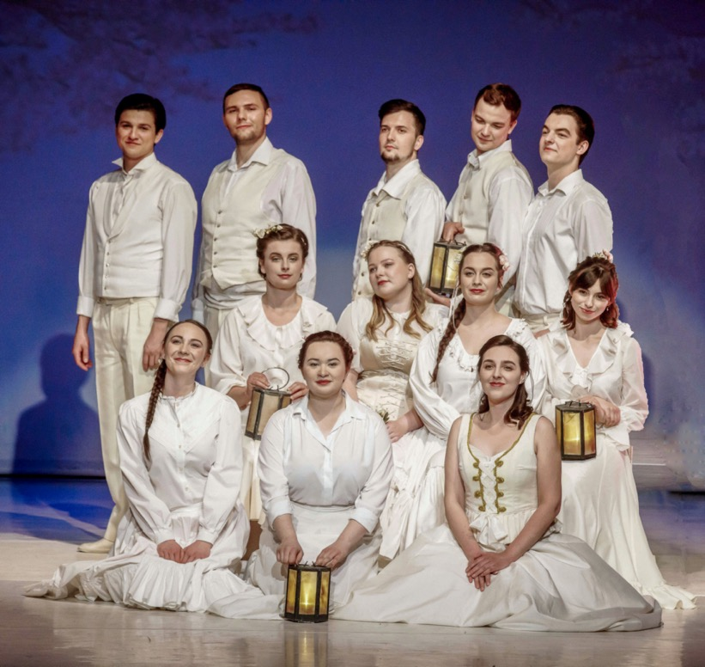
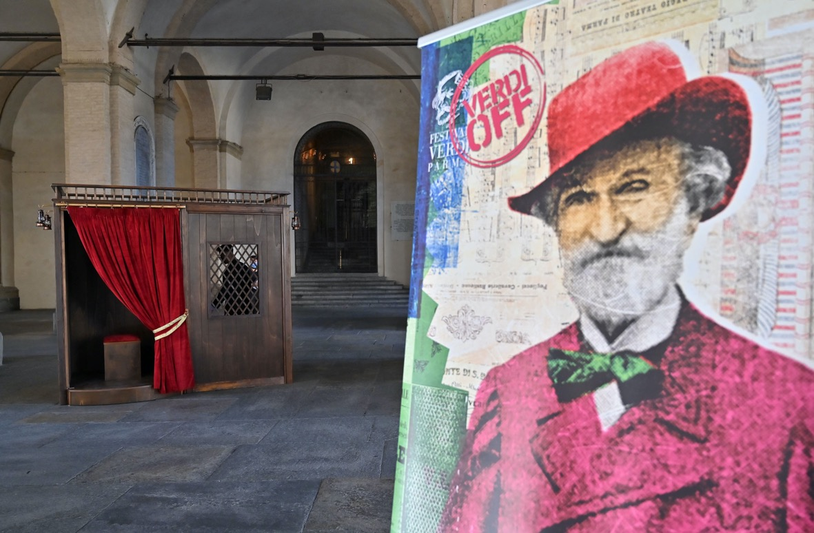
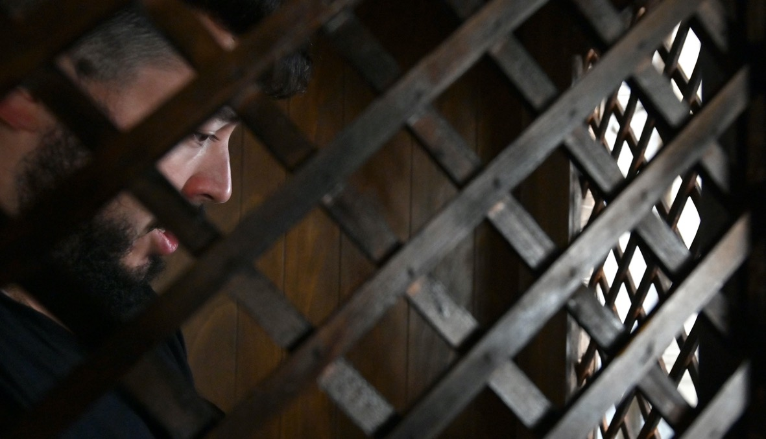
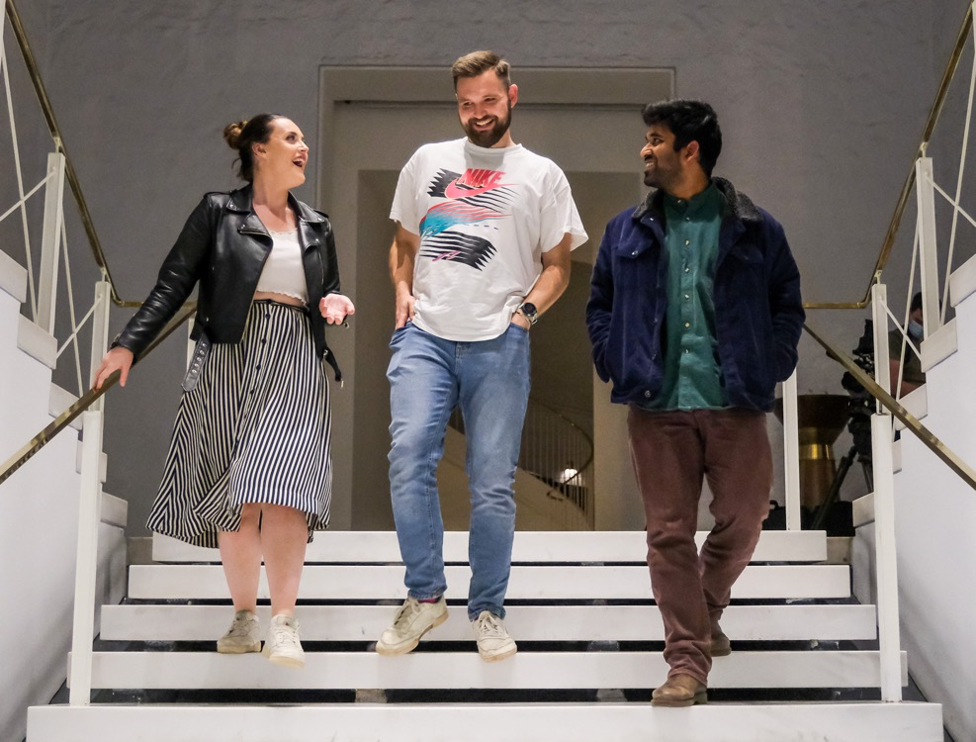
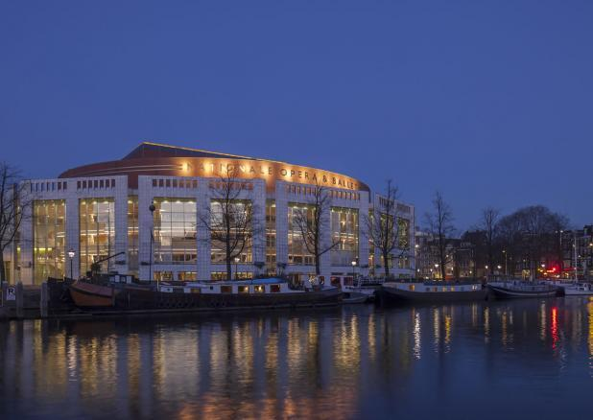
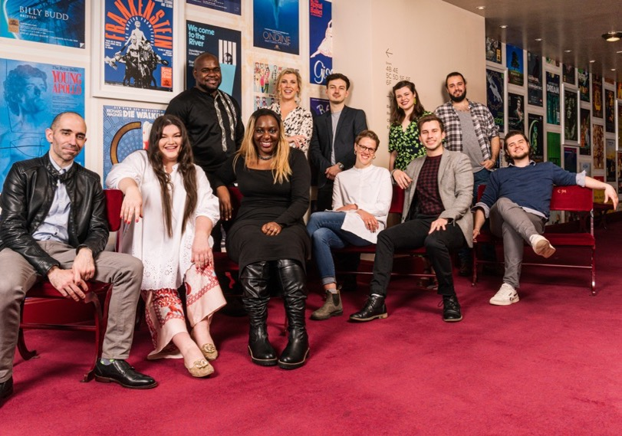

Slide 9


Communication – OperaVision’s contribution
Cultural media campaign
E-mailings to OV 30K subscribers
Intense social media activity
- from Sunday 17/10
Promotion by Opera Europa, members and
networks - Opera America, Ópera Latinoamérica, RESEO, FEDORA, Réunion des Opéras de France, Associazione Teatri Italiani di Tradizione, Opera UK, Association Européenne des Conservatoires, PEARLE…
OperaVision
- one address for the day’s programme.

Slide 10












Slide 11


@operavision
First steps on TikTok
@operavision
ouvre les portes
des Opéras
22 - 25 février
22/02 17h
23/02 17h
24/02 17h
25/02 17h
26/02 17h

Slide 12
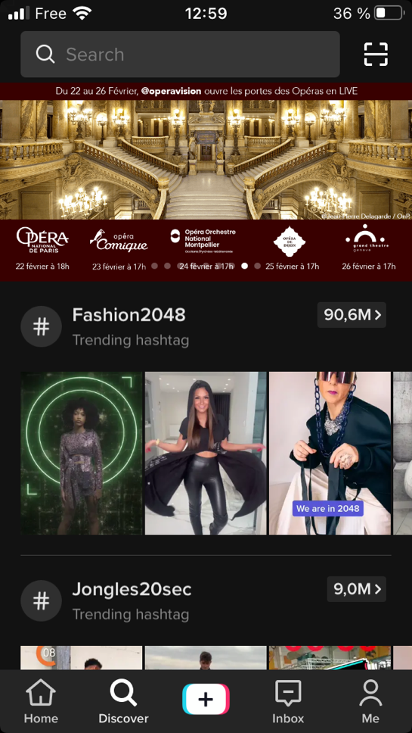
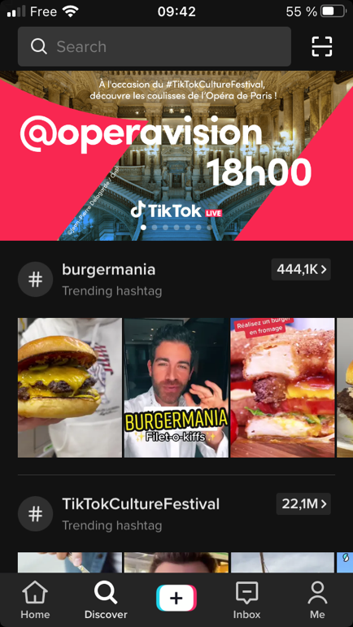
Partnership with TikTok
Willingness to provide advice
Extend reach of our operation
Compromises negotiated
22/02 17h
23/02 17h
24/02 17h
25/02 17h
26/02 17h

Slide 13

Montpellier experience
Link highlights video Montpellier

Slide 14
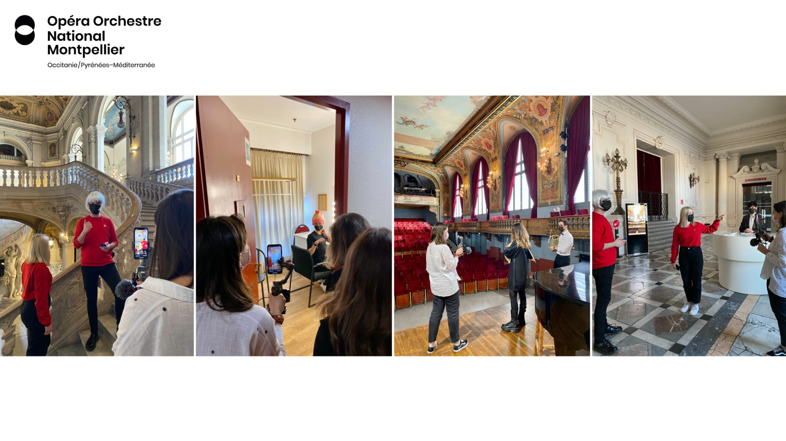

Slide 15
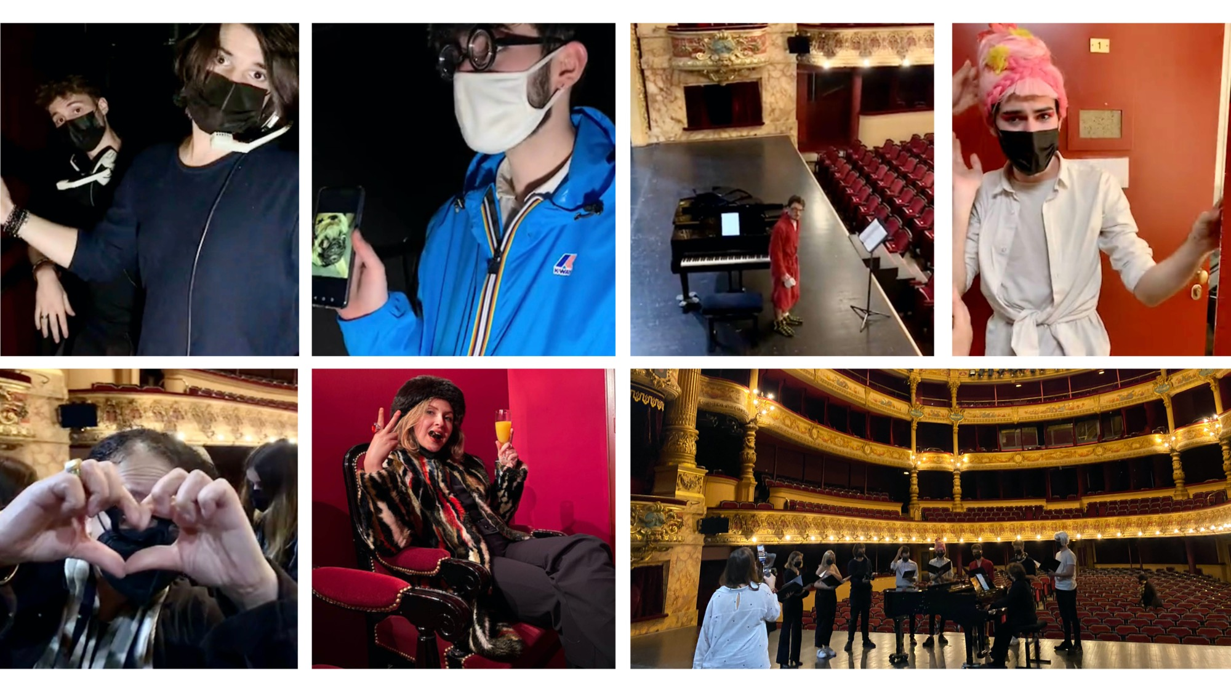

Slide 16
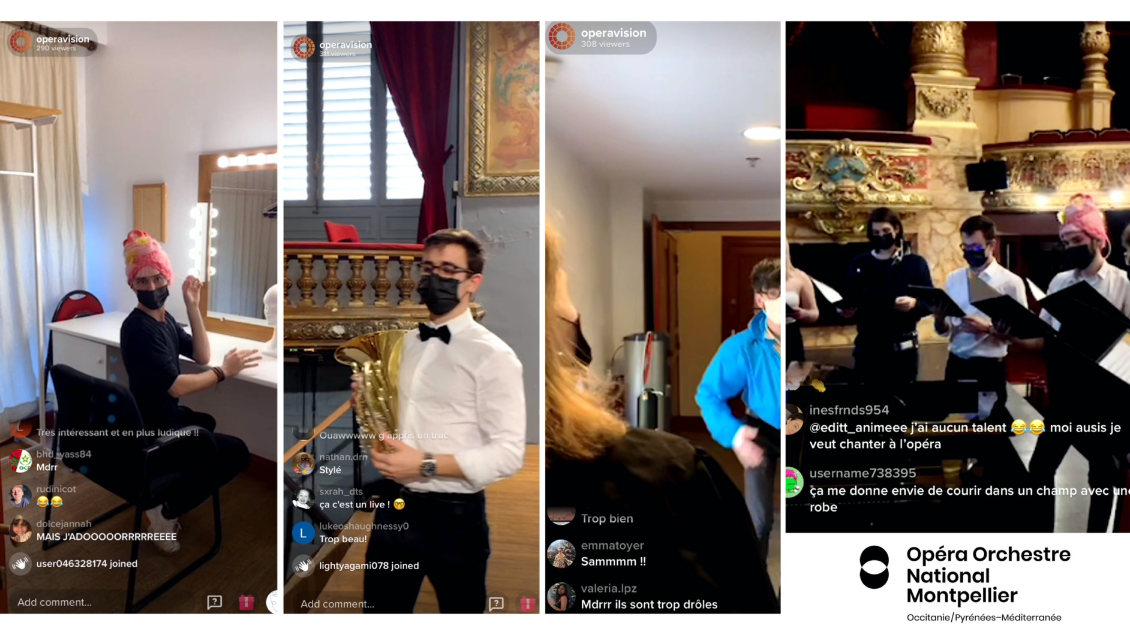

Slide 17
Conclusions first steps
Opera is relatively unknown on the platform; TT offers the potential to introduce opera to a lot of young people
Finding the right content is trial and error
TT algorithms are mysterious and competition is fierce
Working with TikTok staff can enhance your reach but be careful who is setting the agenda.
22/02 17h
23/02 17h
24/02 17h
25/02 17h
26/02 17h

Slide 18
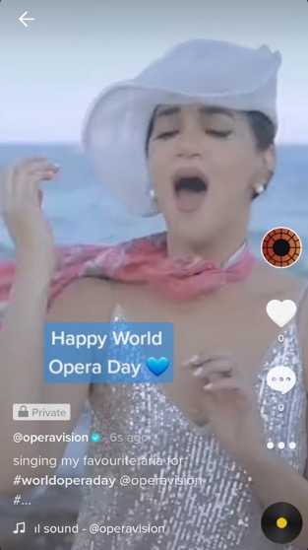
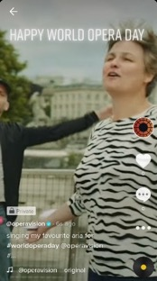
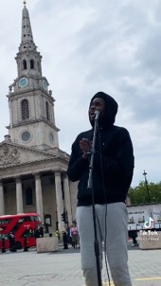
TikTok
Sing outside or from the nice place of your choice
and write on screen: ‘Happy World Opera Day’
- Duration: up to 3 min but recommended 15-30 sec
- Vertical format
- Can be pre-recorded
- N.B. Tag #worldoperaday and @operavision in description
Encourage your young artists to publish from their accounts
Publish from your own institutional TikTok accounts
- If you don’t have one, send it to us in advance and we will publish on OV account
- We are encouraging other young artists to join the movement to give it some following

Slide 19


Luke O’Shaughnessy
luke@opera-Europa.org

