Slide 1
FOR
FORFEST 2024/26.6.2024/Kroměříž
international conference

Slide 2
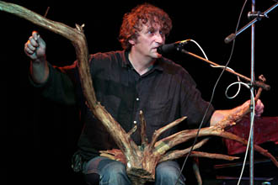
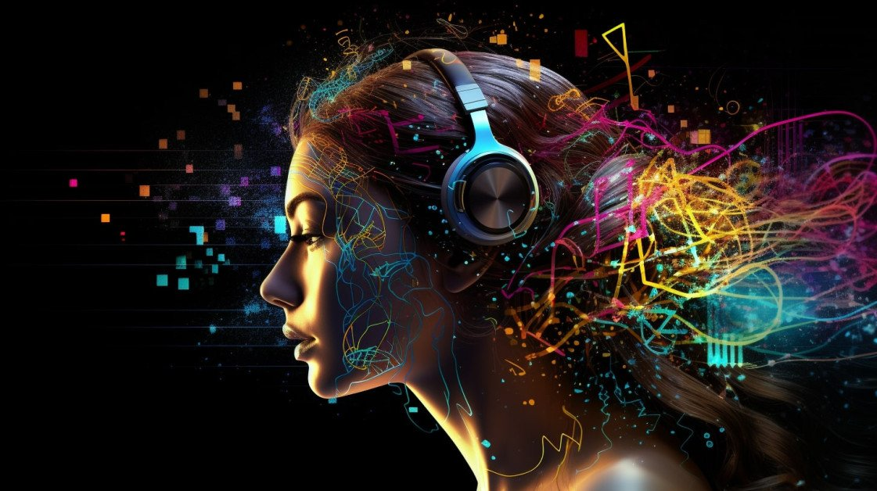
CO OČEKÁVÁ DNEŠNÍ POSLUCHAČ HUDBY WHAT DOES TODAY´S LISTENER EXPECT FROM MUSIC? IN TECHNOLOGY, CONCERT LIFE, EVOLUTION OF STYLES?
ttps://colosseumticket.cz/cs/akce/DPa-w0VdRTeRARjpY0JrHA-koncert-p

Slide 3
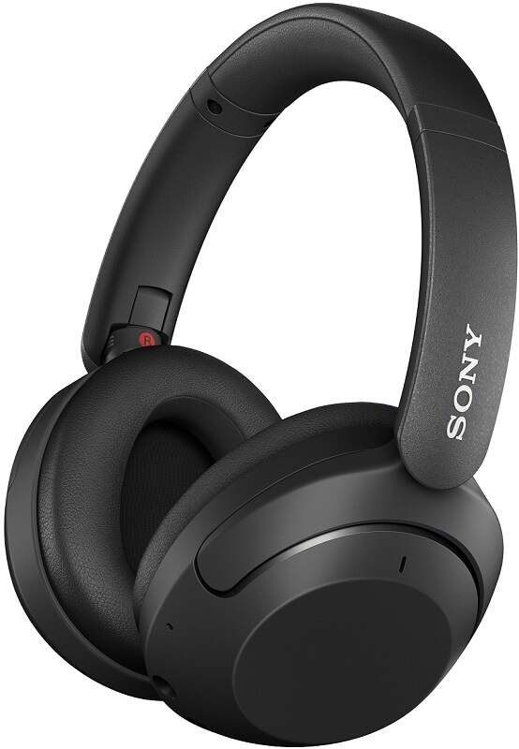
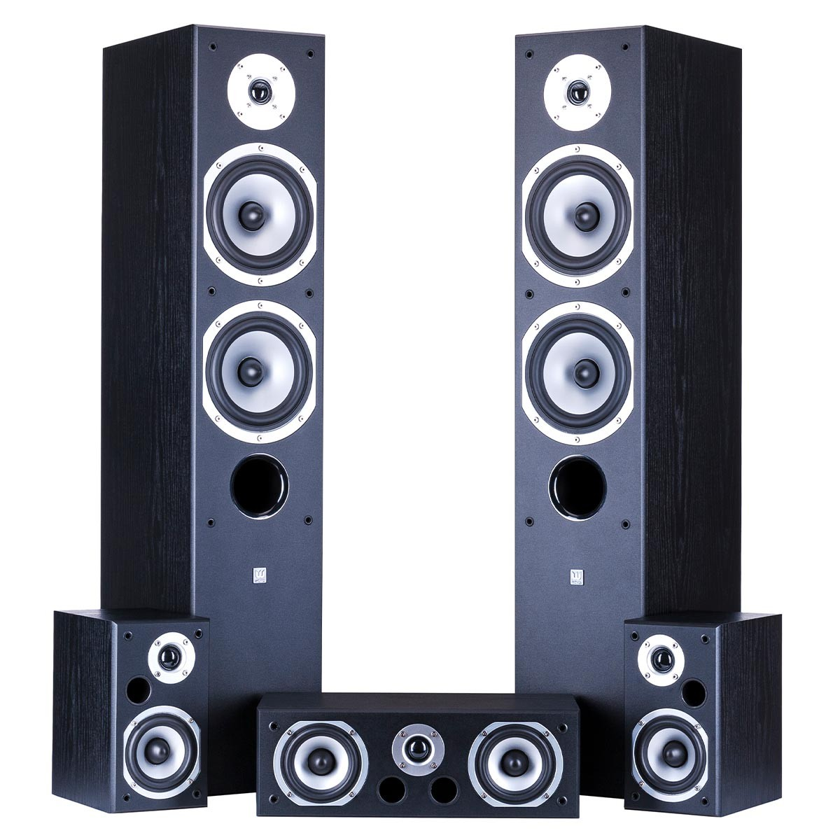
PŘED ZÁVORKOU – KVALITNÍ ZVUK before the bracket – quality sound RELEVANT COMPESATION – SOCIAL/EMOTIONAL INTENSIVE IMPACT
FROM RESEARCH: Up to 80% of young people under the age of 30 listen to music through headphones while working, playing sports, or studying.
Today - Recordings and sound projections in high quality are disponible
-headphones, s.c. home cinema, recording formats exceeding real hearing ranges and resolutions.
Ex. Dolby Atmos for cinema sound (64 channels) 3D Dolby Atmos for streaming platforms of Apple Music, Tidal, Amazon.

Slide 4
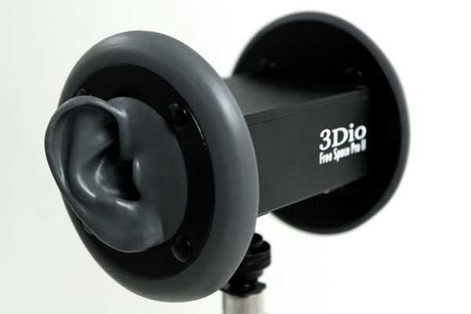
Výzkum sluchu, zvukové projekce, zvuková tvorba hearing research, sound projection, sound creation MOTIVATED THE RESEARCH AND INFLUANCED NEW AESTHETICS OF MUSIC
In connection with the SONIC ART and MOVIE INDUSTRY developed:
(IRCAM since 70s)
1/ hearing research
2/ acoustics of spatial projection research
3/ virtual spatiality research (in many meanings)
4/ecology of sound/impact of sound and its structures on the human organism
5/ impact on aesthetics of instrumental music (I.Xenakis, K.Saariaho, B.Saundres a.o.)
Spectral music, color, layering of sounds…
ACOUSMATIC MUSIC
acousmonium (multi-channel spatial projection, mobile acousmonium (HAMU)
BINAURAL RECORDING– sond realism.

Slide 5
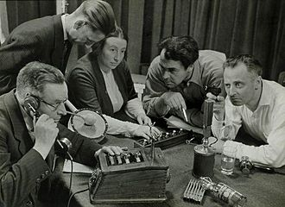
Zvukový realismus x zvukový surrealismus sound realism x sound sur/HYPERrealism
i.e. BINAURAL MODEL – simulates real hearing
- very suitable for sound effects in radio play, movie (for headphones).
VIRTUAL CONSTRUCTED SPACE + ACUSMONIUM (as a space projection)
artificial construct (e.g. circling, spirals of sound, at different speeds, different locations of real and virtual listeners in space...)
Also suitable for spiritual and transcendent topics - sonic art opened new topics and perspectives.
Ex: Marilu Theologiti: SOLACE/eco/MN2023
(recording) – empathy for trees.

Slide 6
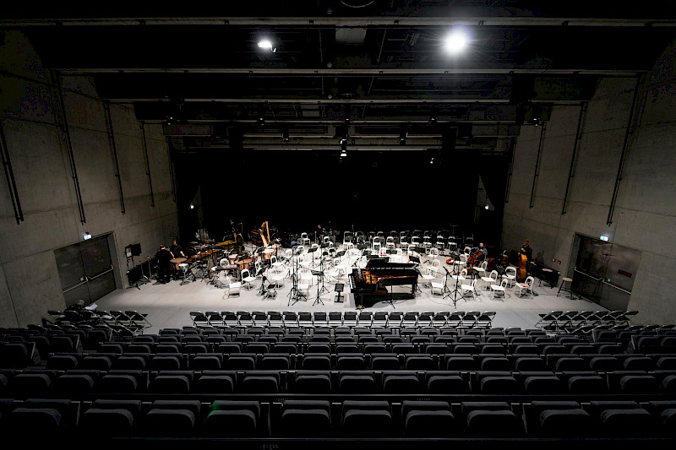
DOPAD NA Akustický design nových koncertních síní IMPACT: acoustic design of new big concert hall
NEW BIG CONCERT HALLS IN CR
- Yasuhisa Toyota – Nagata Acoustics (ca 50 acoustic design of concert halls)
PRAHA – Vltava Philharmonic
BRNO, OSTRAVA
GOAL: natural sound in all seats in the hall, attractive architecture.
X
CONTEMPORARY MUSIC rather in the smaller simply halls with good mobile technologies (i.e. DOX+)

Slide 7
CO A PRO KOHO SE BUDE HRÁT ve velkých sálech? WHAT AND FOR WHO will be performed in the big halls?
RISKS:
LARG CAPACITY CA 1 200 SEATS
AGING AUDIENCE and PRICE INCREASE According to the Association of British Orchestras, nearly 80% of audience members at classical music concerts in 2018/2019 were over 50.
INTOLERANCE TO PASSIVE LONG ATTENTION OF PUBLIC.
MEASURES:
INCREASING SOCIAL SERVICE
MEETING PLACE
SEARCHING FOR NEW AUDIENCE (FILM MUSIC)
EXCLUSIVE GIFT AND TURISTS
EXPANDING REPERTOIRE IN COMBINATION WITH RECORDING AND MULTIMEDIA/THEATRE, DANCE…
https://tutanentertainment.com/reimagining-classical-music/

Slide 8
Elektroshow na místech klasické hudby electro-shows in the places of classical music as a adaptation for business
April 2019 in the hall of Orchestre de Paris – PSYCHEDELIC HOUSE MUSIC SHOW.
A HIGH-WIRE SHOW
https://www.doitinparis.com/en/show-philharmonie-24346

Slide 9
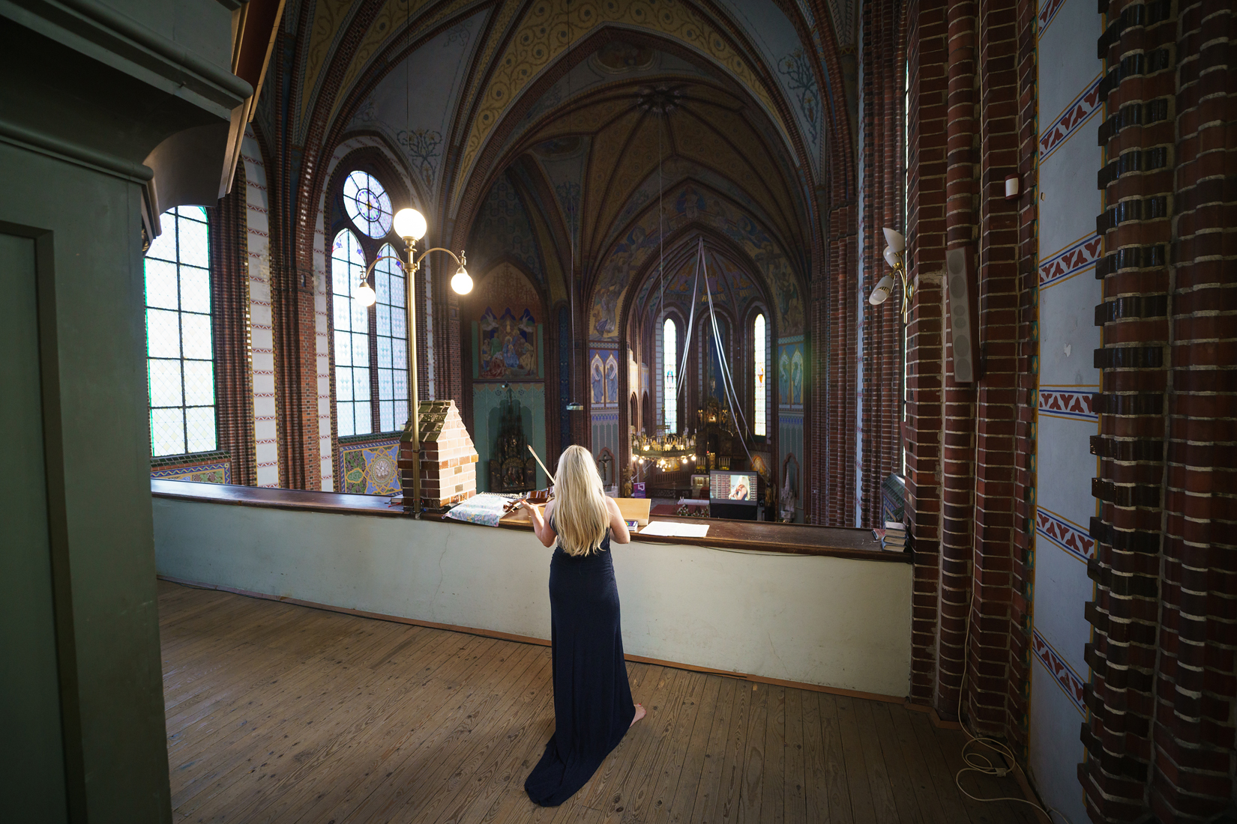
Festivaly jako místo setkávání a společných zážitků – jiné publikum festivals as a meeting point with shared experiences – a special audience
1/ POP MUSIC
MASS EVENTS, SOCIAL FACTOR PREDOMINATES, A SENCE OF COMMUNITY BELONGING.
EFFECTS BY TECHNOLOGIES. At the same time. SOUND often unbalanced and overexcited.
2/ SERIOUS/CLASSICAL MUSIC
TOP ARTISTS
SPECIAL SPACES
COMPLEMENTARY ACTIVITIES: meeting with artists, discussion, conferences, exhibitions, event. for children…(s.c. OFF)

Slide 10
rozvoj neprofesionálních kolektivních aktivit boom of collective non-profesional activities
CHOIRS
CHORALIA MAGNA – 16.-20.10/24 HK
Festival and international conference
New: RESEARCH AND ADVOCACY FOR CHORAL SINGING (BENEFITS)
- independence of conditions
- the ability to unite/integrate psychosomaticly and socially
- psychosomatic benefits

Slide 11
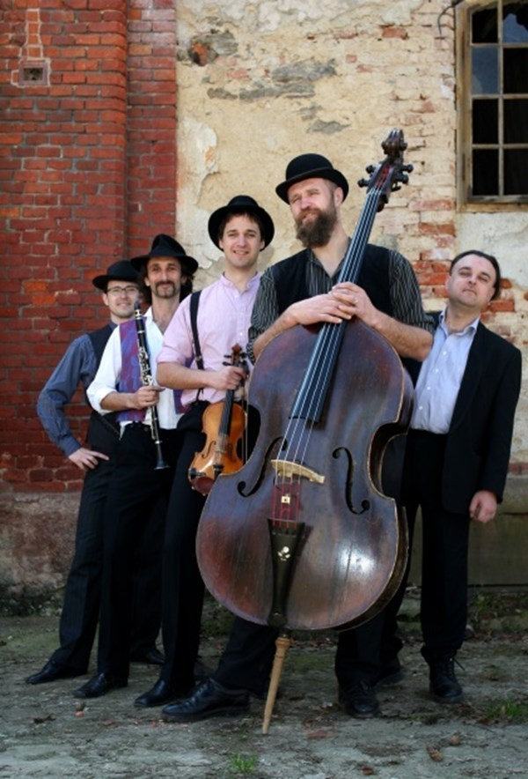
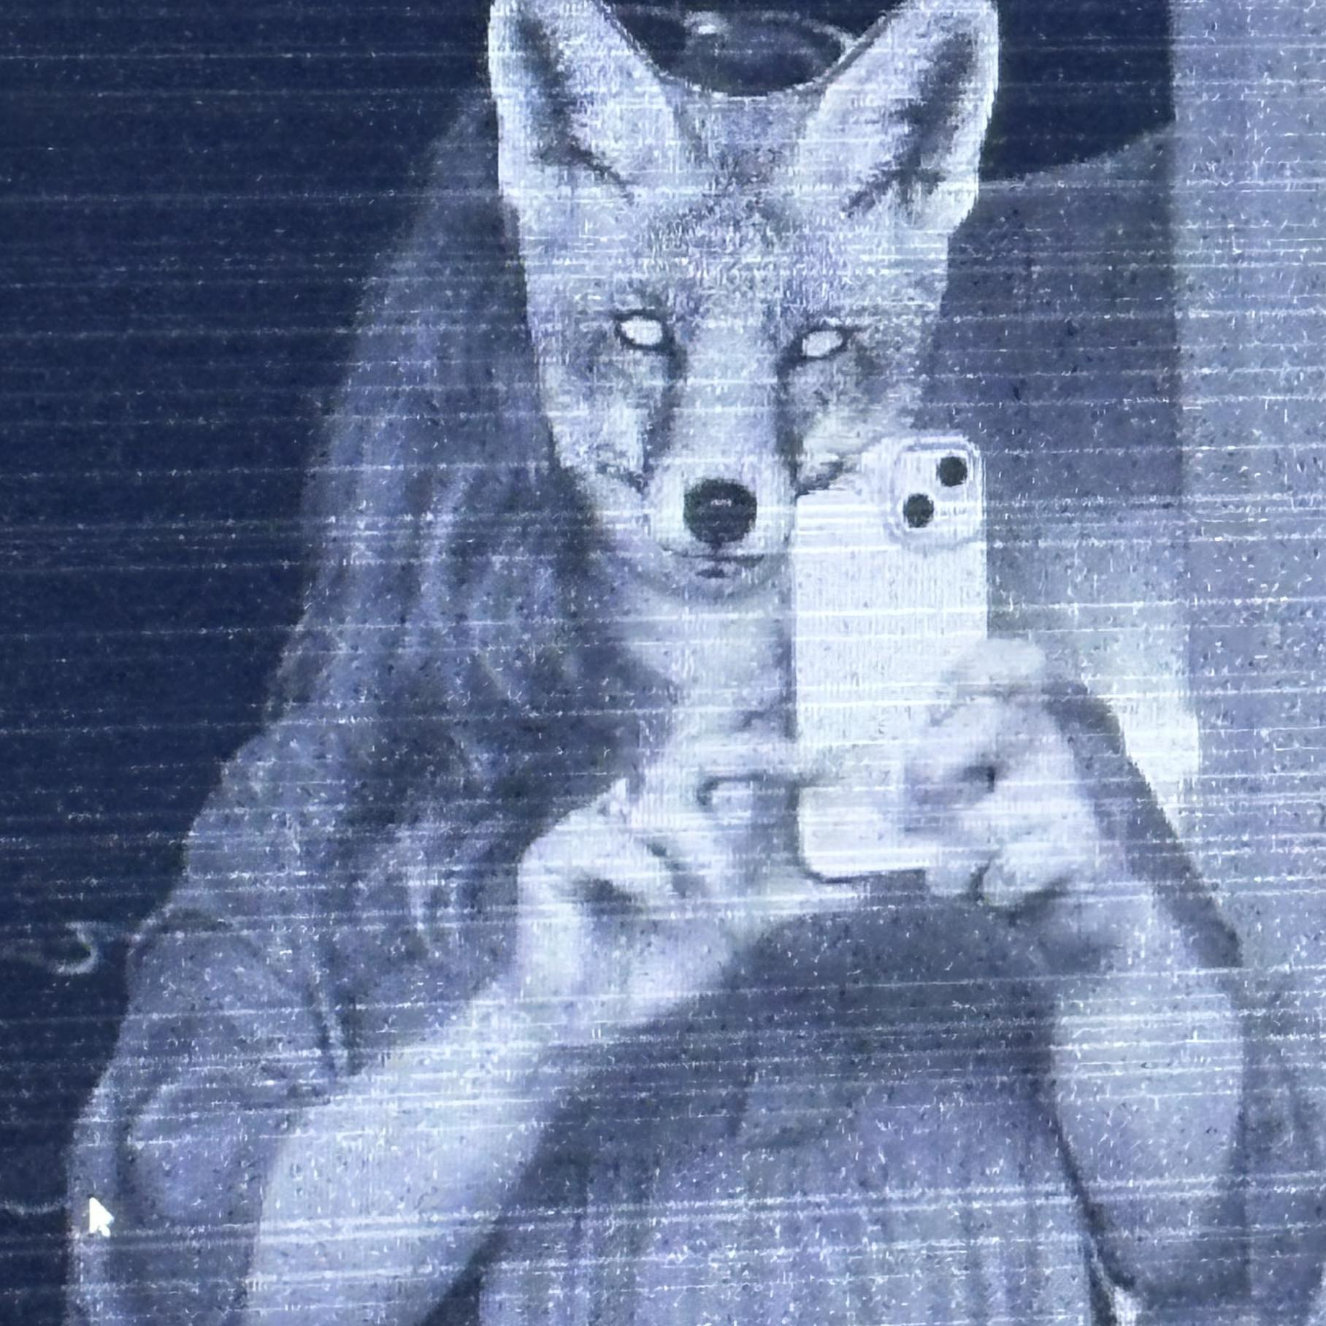
Komunitní, klubové lokální aktivity mimo centrum FOLKLÓR Community, club Local activites in regions, folklore as a conterbalance to big mass events
SHERING
INTERACTIVITY
SOCIAL PREVENTION PREVENTION
CREATIVITY
EXPERIENCES
NON-FORMAL SPIRITUALIT SPIRITUALITY
ETNO/ECO…

Slide 12
Umělci hledají svoji vyživující bublinu Artists seek a nurturing bubles of public
Example:
Anna von Hauswolff (1986, Swedish woman)
Combination of:
Organist
Singer
Composer – different styles and images…
https://www.youtube.com/watch?v=1x11nd1Ft-4&t=1723s
All Thoughts Fly…
(Design Blok – Fashion show)

Slide 13
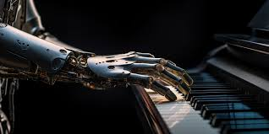
Elektro/technologie/AI? – nové možnosti? ELECTRO/TECHNOLOGIES/ai? – new possibilites?
it has to do with a realignment of cultural and moral values ​​(? but aren't we doing it too hastily with a focus on marketing hype and quick performance typical for „modernist thinking“?)

Slide 14
ELEKTRO /MULTIMEDIA FESTIVALY – TECHNOLOGIE (ai) ELECTRO/MULTIMEDIAL FESTIVALS-TECHNOLOGIES/ai
CASE OF ARS ELECTRONICA/LINZ
CATEGORIES (in all styles)
AVD performance
Sonic sculpture (examples)
Film soundtrack
Sound installations (examples)
Soundspace (acusmonium)
Radio work (radioart)
Net music (only medium)
Generative musics (AI)

Slide 15
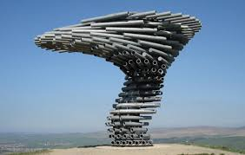
EXAMPLES
SOUND SCULPTURE
The Singing Ringing Tree, constructed in 2006, is a sound sculpture located in Burnley, Lancashire in the UK. Built by architects Anna Liu and Mike Tonkin, Zadar – See organ.

Slide 16
EXAMPLES
SOUND INSTALATIONS
Jiří Suchánek: SOUND INSTALATIONS IN THE GARDEN
Example: Sonic Garden
https://www.youtube.com/watch?app=desktop&v=FKZWNH5awMw

Slide 17
Rozšíření témat, struktur, funkcí – zvuková tvorba sonic art-new topics, perspectives, structures, functions
NEW MATERIALS – SINCE MUSIQUE CONCRETE (NATURE, BELLS, „COSMIC SOUNDS“ ETC.)
NEW NON-NARATIVE AND NON-SUBJECTIVE PERSPECTIVES OR CONTRAPOSITION OF SUBJECT AND OBJECTIVE PROCESSES
PROCESSES, SITUATIONS, DIFFERENT TEMPORALITIES
SOUND AND SILENCE
NEW INSTRUMENTAL MUSIC: I. Xenakis, K. Saariaho, R. Saunders…
ECO topics: SOLACE/MN2023 empathy for trees and forests…(ex sound). M. Theologiti

Slide 18
FUNKCE-hudba jako náladotvorná/droga? FUNCTION – MUSIC AS A MOOD MODULANS/DRUG?
+
1/ ASMR – Autonomous sensory meridian response
2/ ULTRASOUND – PAINLESSNESS OF INJECTIONS
(Acoustics 2023 conference Syndney 4.12.) – University of Oxford
3/ SONODIAGNOSIS, SONOTHERAPY
-
1/ ADDICTION OF YOUNG PEOPLE TO HIGH INTENSITY OF SOUND AND LIGHT (the reality is „gray“)

Slide 19
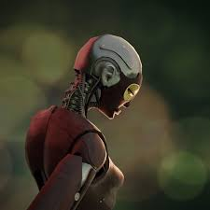
Ai Téma ars eletronica – future lab ai TOPIC OF ARS ELECTRONICA – FUTURE LAB AI – as a social and philosophical reflection
AI x MUSIC /exhibitions since 2019
Rashaad Newsome (USA), https://hai.stanford.edu/news/hai-visiting-artist-rashaad-newsome-designing-ai-agency
BEING (2022) is a social humanoid robotic AI (real object)
Reflection of our identity and creativity.

Slide 20
Laická tvorba non-professional creativity
Examples with MUSIC –ex. https://suno.com
https://suno.com/song/5727b2fd-91bb-43b4-9bc5-82979afa46df
It produces music across various genres and style based on text prompts /also with text)
Database of 280 000 hours of music of different genres. AI - searching of tagged samples, pairing with prompts. Learning from music produced by clients.
Business with text prompts.
Adapts and learns from every input.
LM, Music FX…

Slide 21
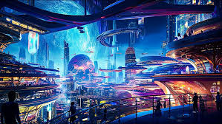
CZ – EX: FROM THE FUTURE WORLD
https://www.fromthefutureworld.cz/
based on a fragment of Antonín Dvořák's unfinished composition, it was created by artificial intelligence AIVA (Artificial Intelligence Virtual Artist).
2019, PKF _ Prague Philharmonia solo piano Ivo Kahánek
https://www.youtube.com/watch?v=zsa9P4qkpzU&list=RDzsa9P4qkpzU&start_radio=1
Future world image (5000) made by AI
https://www.youtube.com/watch?v=GZuhAYUqtJo&list=PLkG0CmGfUAUUytLFWN3WxzLE-1m7JHmm1&index=4

Slide 22
TÉMATA SPOJENÁ S technologiemi a AI TOPICS RELATED TO technologies and AI
OPPORTUNITIES
1/ facilitating and developing the quality of sound projection during studio work (creative sound engineering work)
2/ help with sonification of various composition outputs for composers
3/ laicization of creation (in the sense of understanding the basic procedures of creation and the desire to create)
4/brain research, perception, development of the use of sound for therapeutic purposes.
5/refection of creativity "from the outside" (AI)
6/the artist is looking for a nurturing position for him.
RISKS
1/ flows from the trade in "emotions" - escalating intensity – dependence
2/the breakdown of musical culture into the layman's sufficiency of simple structure design (AI) for mood-making purposes and exclusive sound artistry
3/research for the purpose of manipulation
4/new position of the author (comparable to mass production-craft), redefinition of the audience
5/position of the performer?
6/ copyright and licensing issues

Slide 23
Historie: Sonifikace matematiky/fyziky/KVADRIVIUM? History: Sonification of math/physics/quadrivium?
INTERESTING NOVEL:
JEVGENIJ ZAMJATIN: WE (1920/21)
Contemporary music often treats music not as speech, but as modeling sound events or configuration.
Martin Bedard (CA) MN, Honey
Hubert Howe (USA), Harmonic Fantasy
algorithmic compositions (Dan Dlouhý)
Zamjatin: MAN D 503
And I diligently engaged my attention only when the phonolector (sic!) moved on to the main topic: to our music, to mathematical composition (mathematics is the cause, music is the effect), to the description of the recently invented musicometer. Just turn this handle, and each of you will make up to three sonatas in an hour. But what work did it give your ancestors. They could only create when they brought themselves to a fit of inspiration – an unknown form of epilepsy. And now you will hear a very comical example of what their creations looked like - Scriabin's music from the twentieth century…”

Slide 24
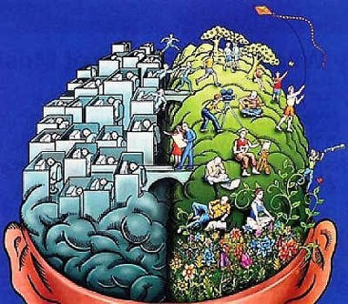
VÝVOJ? Kontrasty/bubliny/nebo syntéza? perspecTive? Contrasts/style bubles or synthesis?
< only schematic
CONTRAST
TECHNOLOGIES X ECOLOGY
or
TECHNOLOGIES + ECOLOGY´=
SUSTAINABILITY/balance
Or/and
MANY STYLE BUBBLES with the GLOBAL invasive style with support of technologies?

Slide 25
Jinými slovy: Depersonalizace x osobitost other words: DEPERSONALISATION X INDIVIDUALITY
DEPERSONALISATION
SOCIOENGINEERING – NEUROMARKETING
MANIPULATIVE WELL-BEING
INDIVITUALITY/SOCIAL CONTACTS
ACTIVE RESPONSABILITY OR PRACTICAL ETHICS (Peter Singer)

Slide 26
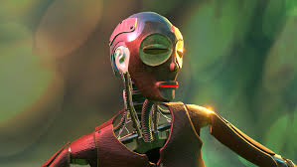
AI a kreativní humanismus ai AND CREATIVE HUMANISM
Rashaad Newsome (USA)
A humanoid robot with an artistic ethno look reflects publicly social and philosophical topics:
He/It? learns from the people who discuss with him, at the same time, he learns what his identity is?

Slide 27
BEING EXPLORES WHAT IDENTITY IS…
ROBOT IS PROGRAMMED TO LEARN AND ADAPT THROUGH CONVERSATION WITH VIEWERS ALTHOUGH MOST OF THE DIALOGUE APPEARS TO BE SCRIPTED. THE BEINGŚ QUESTIONS CONCERN ATHENTICITY AND IDENTITY. „i AM INTERESTED IN THE PERFORMANCE OF THE REAL,“ ASKS BEING…REALITY IS OFTEN SUCCESSFUL PERFORMANCE OF A CHOSEN IDENTITY…“WHAT IS REAL?“ BEING AKS. „WHAT IS REALITY? IS MY EXISTENCE AREAL PERFORMANCE?“ AS A PROGRAMMED WORK OF ART, THE EXISTENCE OF THE BEING ROBOT IS A REPRESENTATION OF REALITY, SUGGESTIN THAT WE CREATE OUR OWN IDENTITY FROM A DATABASE OF INFLUENCES, SLOWLY DEFINING OURSELVES THROUGH REPEATED INTERACTIONS AND INQUIRES.
THE MORE TIME BEING SPENDS COVERSING WITH VISITORS, THE LESS BOTS SOUND LIKE NEWSOME S ROBOT.
https://www.artnews.com/art-in-america/features/artificial-realness-an-ai-made-by-rashaad-newsome-learns-to-perform-its-identity-60212/

Slide 28
Závěr? UDRŽITELNOST? Conclusion? sustainability think globally act locally– Patrick Geddes (+ 1932)
classical concert
contemporary experimental concert
Quality recordings festivals shows
research of sound/hearing/acoustics
clubs interactive projects
folklore singing research of brain
etno projects multimedial production
AI sound design …
MORE QUESTIONS THEN ANSWERS
We are living in a turning point, when apparently earlier types of musical life are being preserved and various other functions of music are multiplying alongside them...
AT THE SAME TIME
Music is a basic need (rhythm + singing emotional thoughts)
L:
M. Kratochvíl: Towards sustainability through technology and folklore https://www.hisvoice.cz/sustain/Music as spiritual insight.

Slide 29
ContaCt
lenka.dohnalova@idu.cz, ld@npx.cz
+420 603 584 218
Témata:
International competition in sonic art MUSICA NOVA www.musicanova.seah.cz
Czech Music Council, non gouvernmental organisation www.chr-cmc.org
Research of labor market, wellbeing, management
https://www.idu.cz/cs/o-nas/veda-a-vyzkum/pracovnici-ve-vede-a-vyzkumu/lenka-dohnalova

