Slide 1


Neuro-Music-Education and the Default Mode Network
International Conference of the Czech Music Council
Complex Impact of Music on Pedagogical Processes
10th November Prague
Wolfgang Mastnak
University of Music and Theatre Munich / Beijing Normal University
European Academy of Sciences and Arts / New York Academy of Sciences

Slide 2
Neuro-Music-Education
Educational phenomena
Psychological
explanation
Neuroscientific
substantiation
Music
Auditory cortex
Self-referencing
Reward system
Default mode network

Slide 3
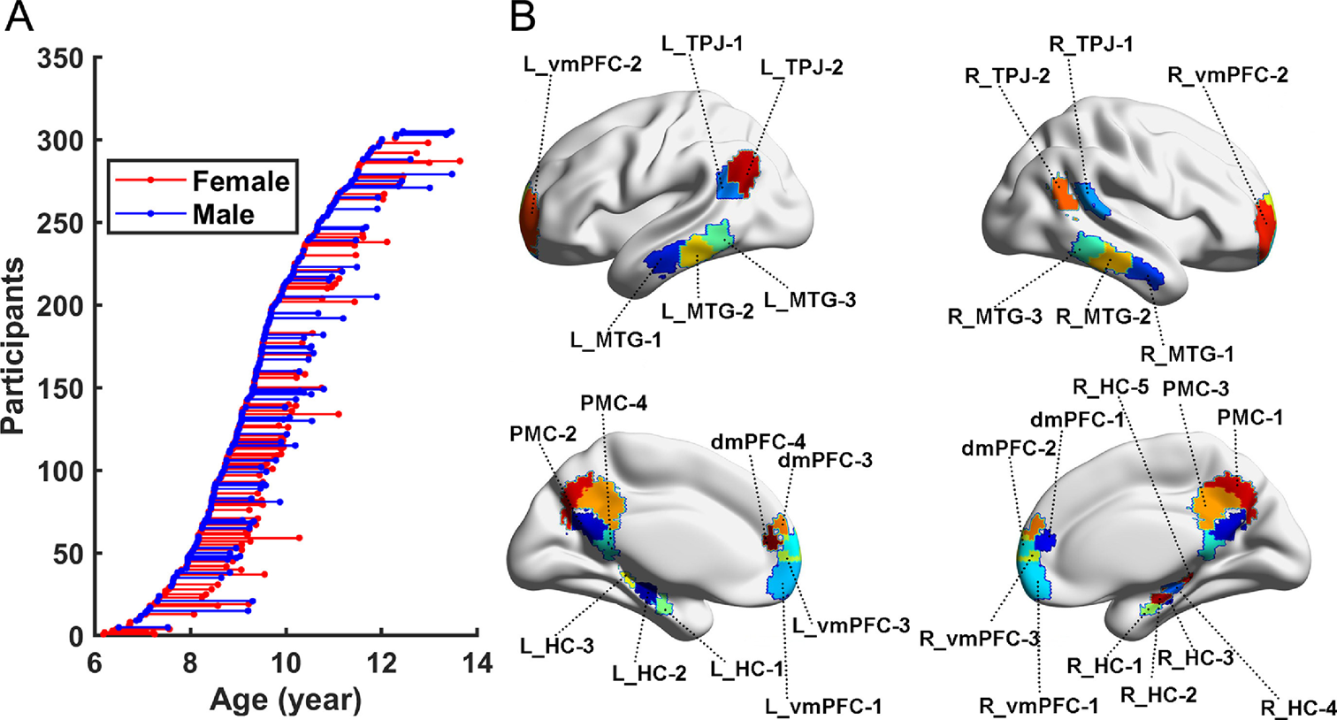
Default Mode Network
DMN
Self- & Bio-Referencing
Posterior cingulate cortex & precuneus
Medial prefrontal cortex
Angular gyrus
Social Referencing
Dorsal medial prefrontal cortex
Temporoparietal junction
Lateral temporal cortex
Anterior temporal pole
Auto-Bio (Past) & Future Simulation
Hippocampus
Parahippocampus
Retrosplenial cortex
Posterior inferior parietal lobe
Development of the default-mode network during childhood and adolescence: A longitudinal resting-state fMRI study. Fan F, Liao X, Lei T, Zhao T, Xia M, Men W, Wang Y, Hu M, Liu J, Qin S, Tan S, Gao JH, Dong Q, Tao S, He Y. Neuroimage. 2021 Feb 1;226:117581. doi: 10.1016/j.neuroimage.2020.117581.
CC BY 4.0

Slide 4
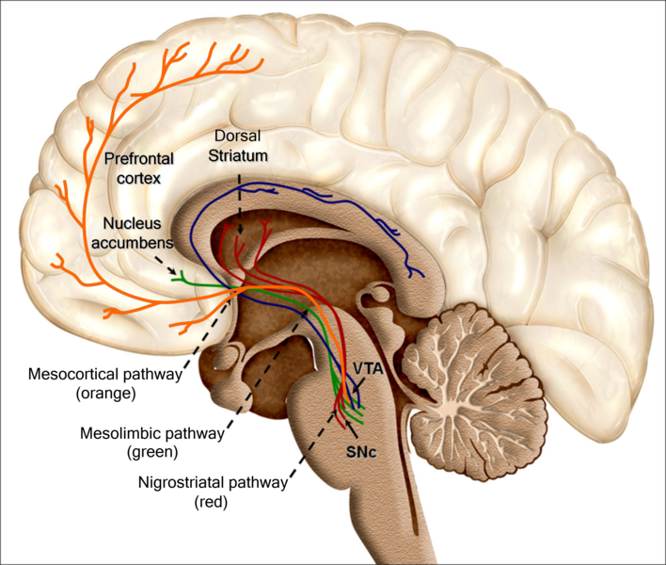
Aesthetic experience
& DMN
Reward
system
DMN
Auditory
Cortex
CC BY 2.0
Oscar Arias-Carrión, Maria Stamelou, Eric Murillo-Rodríguez, Manuel Menéndez-González and Ernst Pöppel. Dopaminergic reward system: a short integrative review. International Archives of Medicine 2010, 3:24 doi:10.1186/1755-7682-3-24

Slide 5
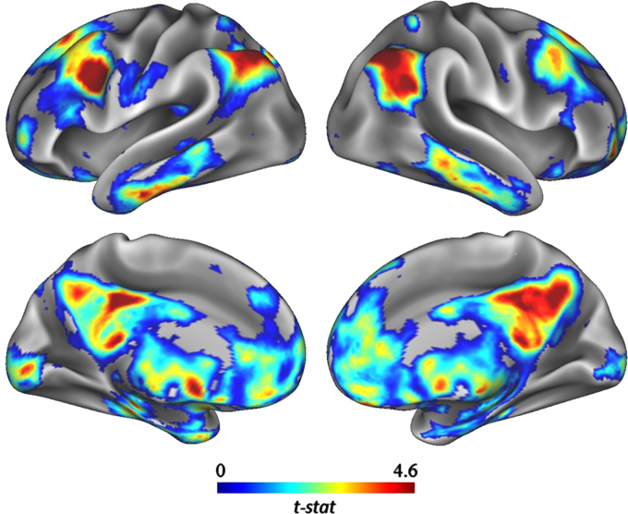
Creativity & DMN
Music
Divergent
thinking
Flow
DMN
Intrinsic
arousal
CC BY 3.0
Creativity and the default network: A functional connectivity analysis of the creative brain at rest. Beaty RE, Benedek M, Wilkins RW, Jauk E, Fink A, Silvia PJ, Hodges DA, Koschutnig K, Neubauer AC. Neuropsychologia. 2014 Nov; 64:92-8.
doi: 10.1016/j.neuropsychologia.2014.09.019.

Slide 6

& intrinsic processing
DMN
Music
& DMN
Mind wandering
Unconscious
Self-processing
Altered states of consciousness
Immersion
Meditation
Music
education
Auto-hypnosis
https://www.gettyimages.co.uk/detail/photo/
buddha-statue-royalty-free-image/485020819?adppopup=true

Slide 7
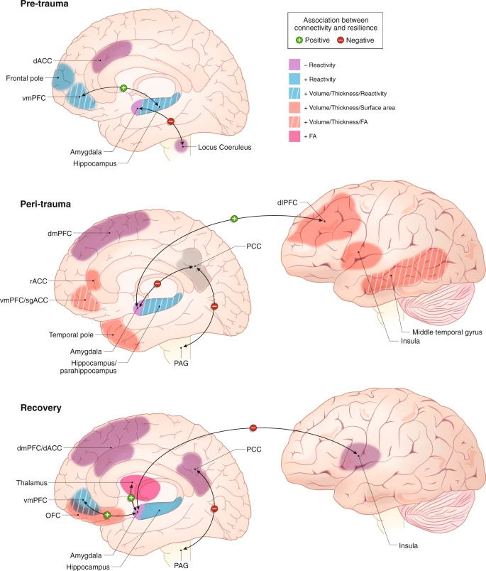
DMN & resilience
Music
& DMN
Post-COVID-19
Stress-Burnout-Prevention
Creative
empowerment
Personal
growth
CC BY 4.0
Roeckner, A.R., Oliver, K.I., Lebois, L.A.M. et al. Neural contributors to trauma resilience: a review of longitudinal neuroimaging studies. Transl Psychiatry 11, 508 (2021). https://doi.org/10.1038/s41398-021-01633-y

Slide 8
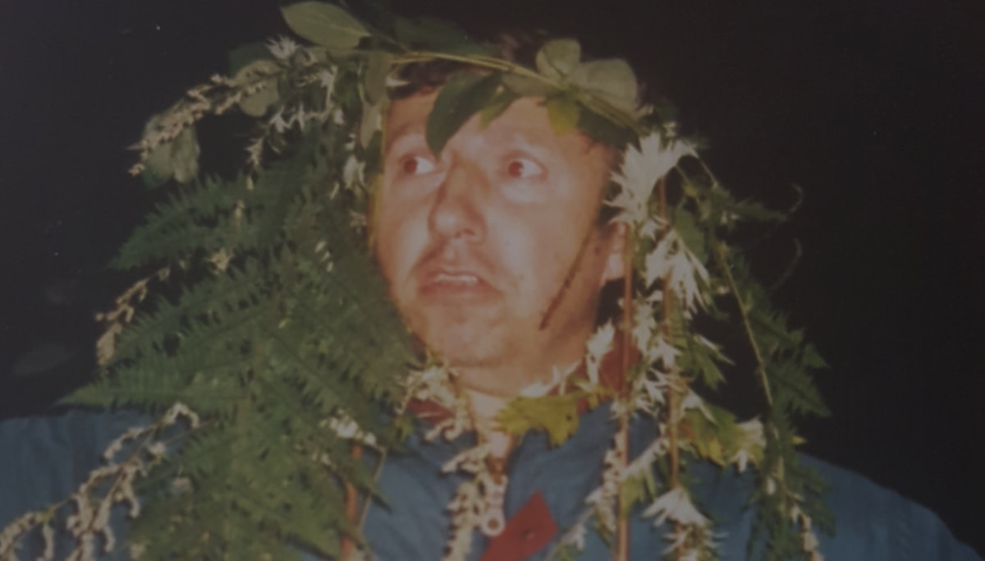
Thank you ...
... for listening!

