Slide 1
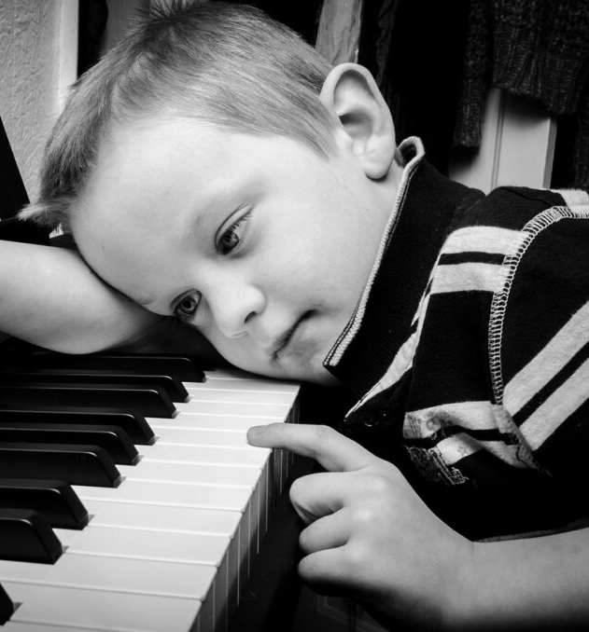
Music-based education: how to get evidence into use?
Doc. Mgr. Jiří Kantor, Ph.D.

Slide 2
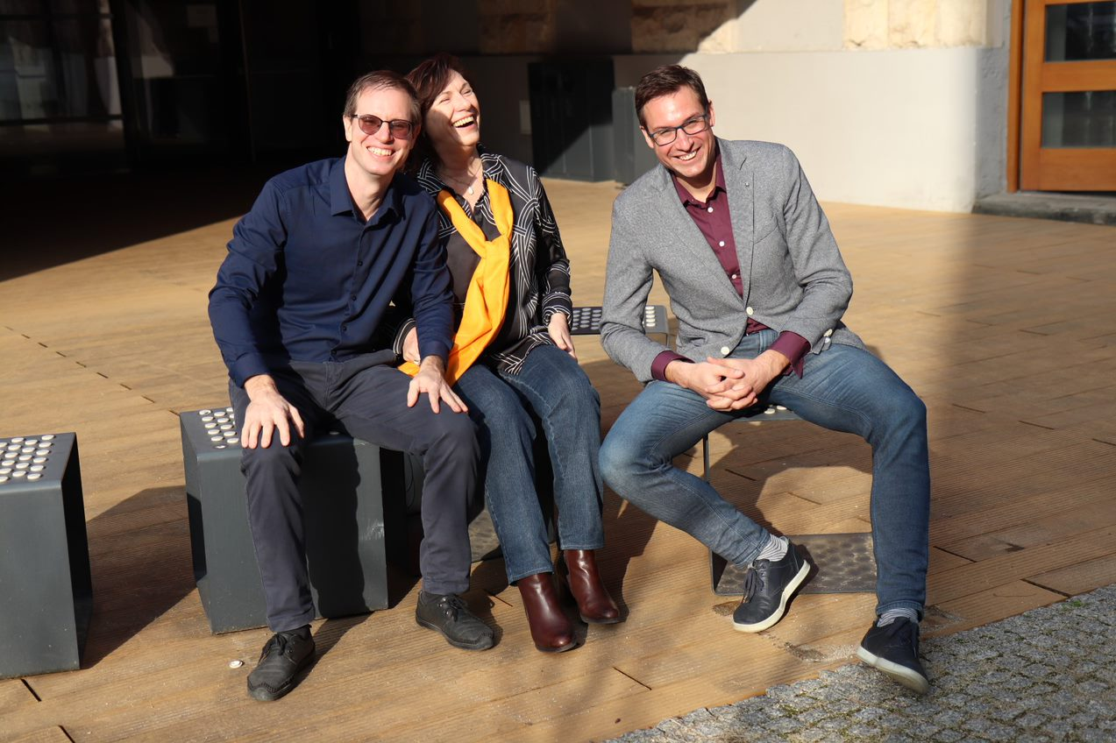
Disclosure
Center for Evidence-Based Education and Arts Therapies: A JBI Affiliated Group (director) and GRADE for Education (group co-leader), affiliated to the Evidence-based centre for education and arts therapies (EduArt), Faculty of Education, Palacky University Olomouc (director)
MA study program in Music Therapy, Faculty of Education, Palacky University Olomouc (guarantor)
Music Therapy Association of Czech Republic (member of professional committee)
National Spiritual Assembly of the Baha´í Community in the Czech Republic (member)
There may exist an „intellectual conflicts of interest“ because of my institutional affiliations and responsibilities:

Slide 3

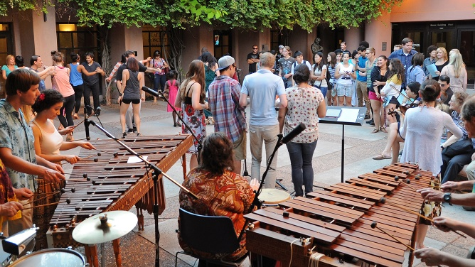

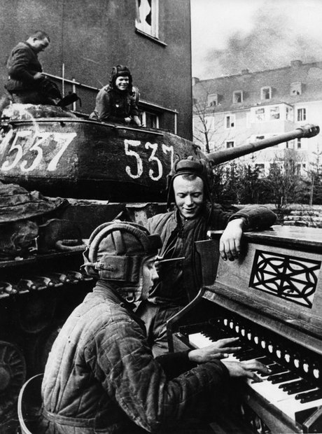
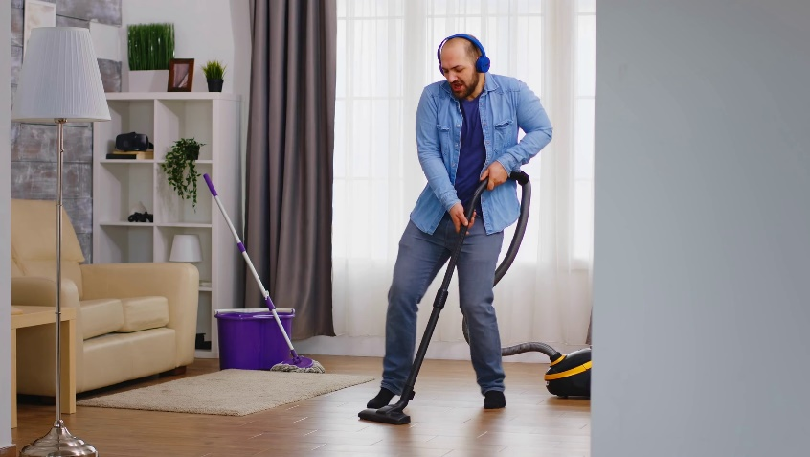
Value of music in human life
The true value of music goes far beyond a purely aesthetic purpose
It can be used functionally in many important areas of human life:
for therapy,
for education in non-musical areas,
for personal growth and social change,
for team / community building, etc.

Slide 4

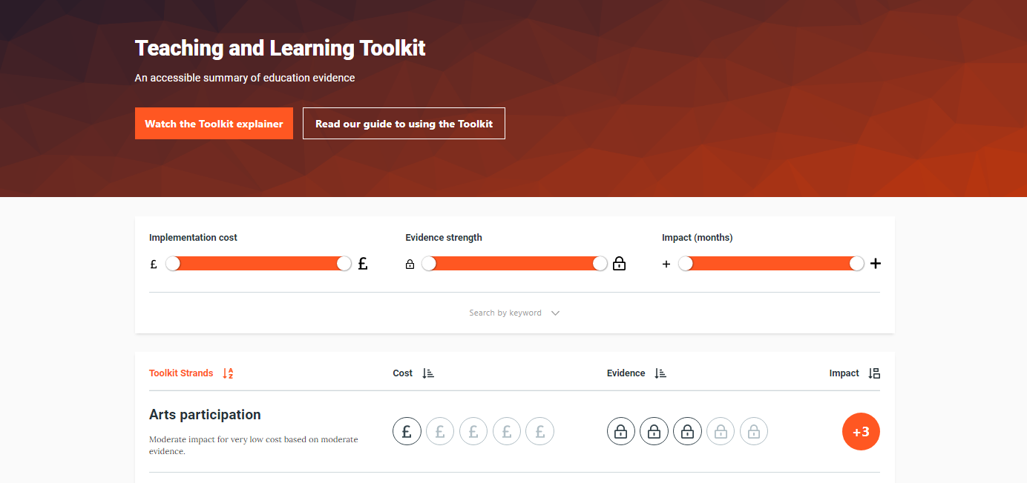
There is a growing evidence concerning the usage of arts in education and everyday life…

Slide 5
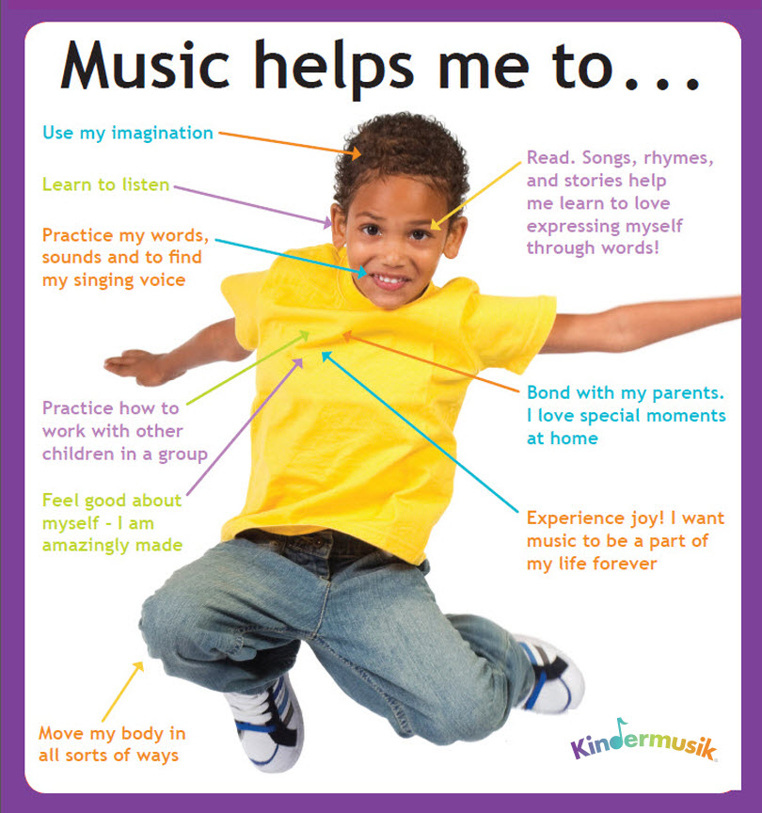
…but teachers need to acknowledge and use different values of arts
- Many teachers and other stakeholders in education are usually not only unfamiliar with the evidence regarding the various applications of music
- They usually don´t consider ​​how music could be used for other than aesthetic purposes in their educational practice.

Slide 6
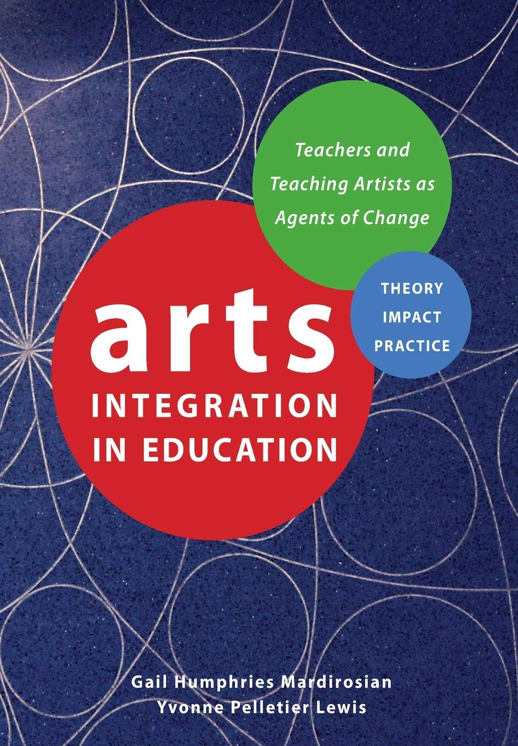
How to support using arts in education?
- Teachers need not only to understand different ways how music can be used in education
- They need to gain their own experience with different methods of „arts in education“ to be able to use these methods
- This should optimally start at the undergraduate level of university education

Slide 7
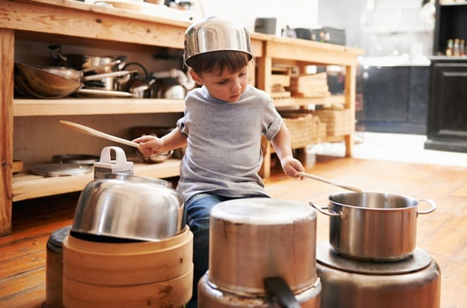
What do we need?
There are many questions connected to the implementation of arts in education which are far beyond the capacity of this presentation
One practical example – based on our experience from Faculty of Education, University Palacky Olomouc, the students need to learn protocols for Music in Education that are:
simple
easy to be used in practice
not time consuming or requiring expensive equipment
not requiring highly professional artistic skills
closely connected to the curriculum

Slide 8
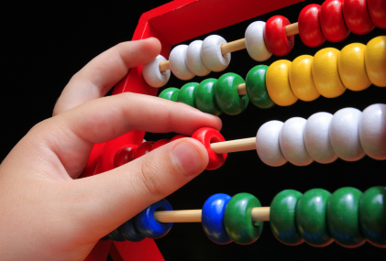
Protocol examples – counting for preschool children
1. Summation
2. Substraction
3. Mutliplication
4. Division
The exercises are designated for preschool children, but may be useful also for school children with special needs
For students of music therapy study program, we developed a series of musical protocols for cognitive training and learning in different school curriculum
I will present here an example of exercises focused on development of basic mathematical skills and concepts:

Slide 9
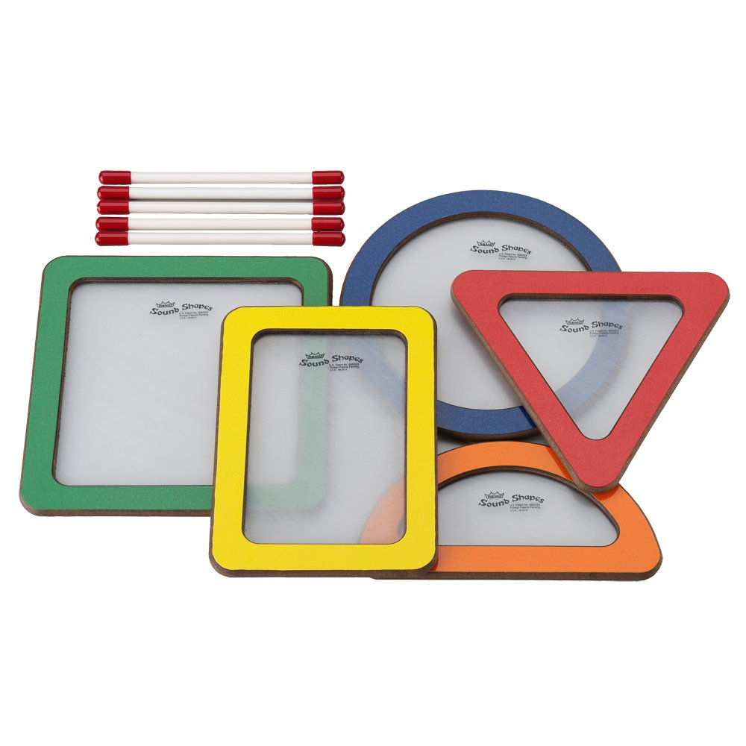
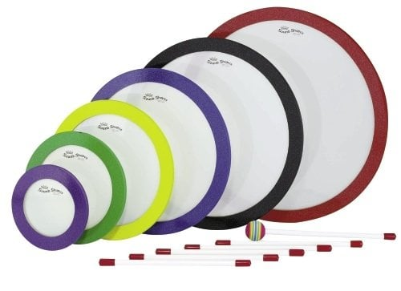
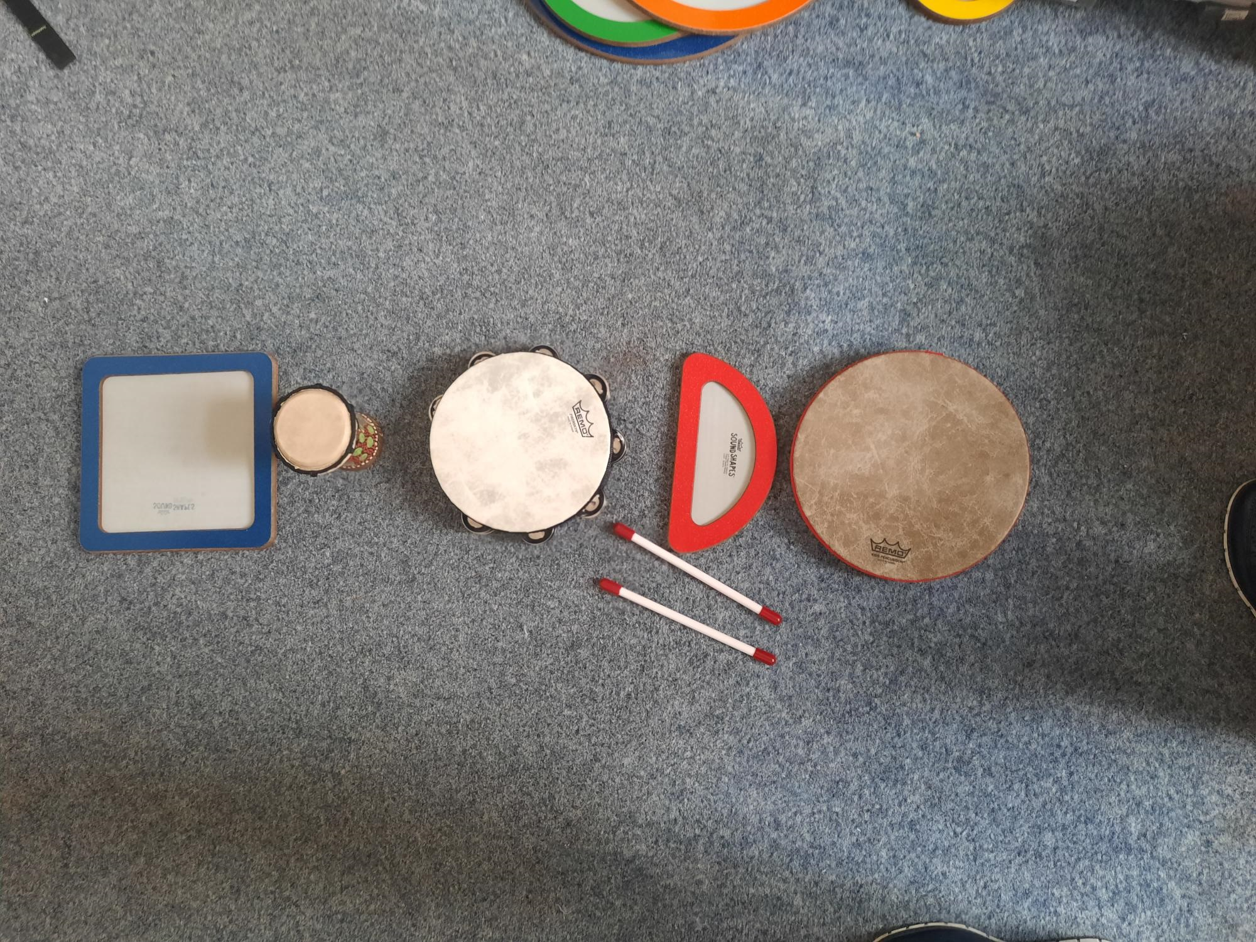
Equipment
Set of drums with different shapes, colour, sizes and sounds

Slide 10
Understanding the concept of numbers / their order
Play and count
Every number must have its own identity in sound, colour, shape, size, etc.
Verbal counting of sounds can be supported by visualisation of the numbers (for usage of more abstract concepts in later stages of learning)

Slide 11
Summation
Example: 3 + 2 = 5
play three beats (on three drums)
play other two beats (add other two drums)
play once more on all five drums present and count how many beats are played

Slide 12
Substracation
Example: 5 – 3 = 2
Put five drums on the table
Play three beats
Count how many drums were not played yet (2 beats or 2 drums)

Slide 13
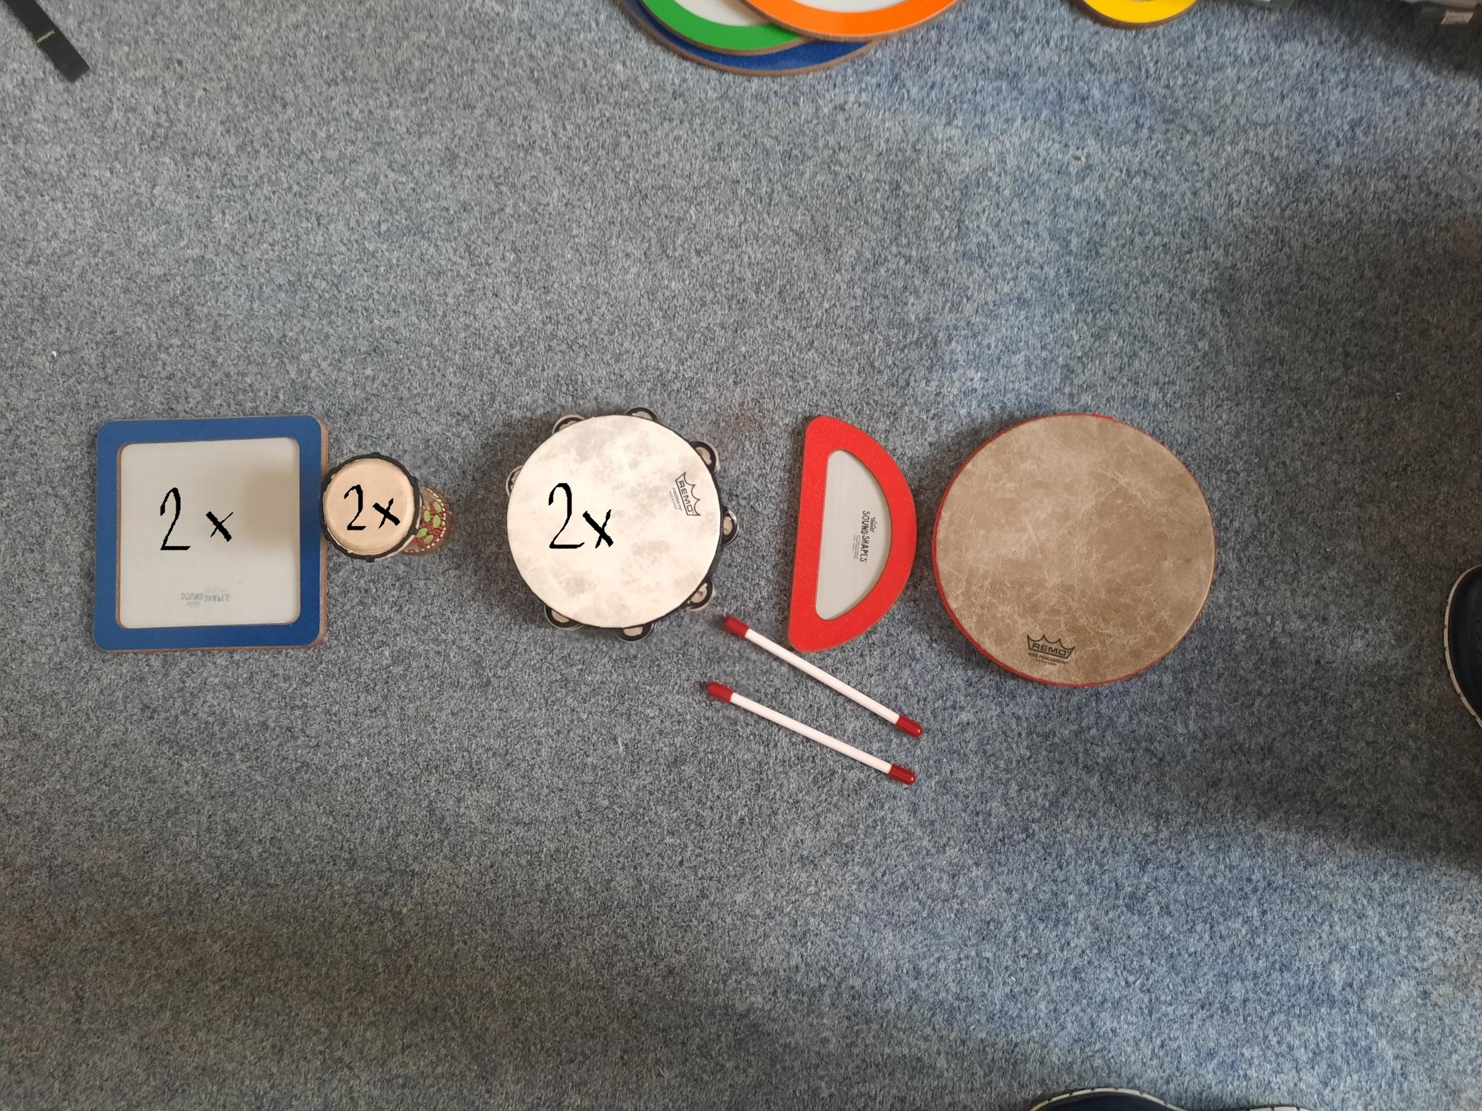
Multiplication
First introduce the concept that we can play more beats on every drum
Example: 3 x 2 = 6
Prepare thre drums
Each drum will be played two beats
Count how many beats were played
Multiplication is repeated summation of the same groups

Slide 14

Division
6 : 2 = 3
Prepare two drums and play every drum one beat
Sum how many times you must play these two beats to achieve six beats (3 times)

Slide 15
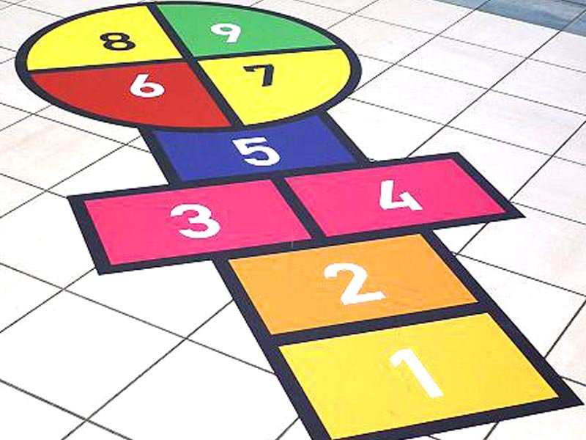
Using movement
Jump and count for learning the sequence of numbers

Slide 16
Counting and movement

Slide 17
How it might work?
Supporting multiple systems of perception (visual, auditory, kinesthetic…) enables activation of many brain centres and networks while learning
Difficulties in some areas (eg. visual working memory) may be more easily compensated by other functions (eg. by phonological loop using the auditory feedback)
Every number has its own identity in sound, shape, colour, etc.
The abstract concepts are supported by concrete images that enables gradual development of abstraction (eg. the pupil can see the sequence of all numbers we use for counting)
Supporting motivation, making fun – these exercises may be use to create games that enables extensive repetition and practice without getting bored…
Some hypothesis:

Slide 18
Conclusion
The true value of music in education reaches far beyond the aesthetic goals.
The arts are under-used in educational practice, although there is evidence about the impact of arts on academic and other outcomes.
The situation could be improved by implementing lessons on arts in education directly during pregraduate preparation of students of pedagogical faculties
We need to develop practical protocols and models of „arts integration into education“ that will be easy to use and closely connected to curricular areas
An example of such exercises was introduced here – focused on basic mathematical skills
The effects of such protocols should be explored by subsequent research with the aim to iedntify what works best, for what, for whom, under what conditions, etc.
The implementation of these protocols into practice may be supported by implementation projects based on the most effective methods of implementation science

Slide 19
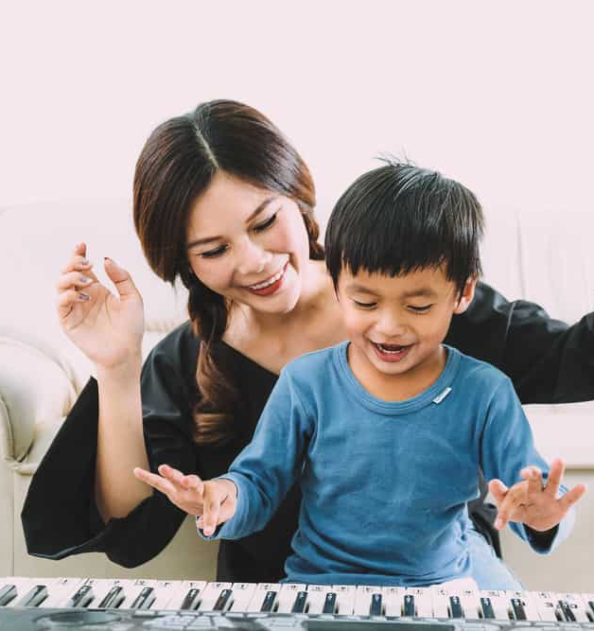
Thank you for your attention!

