Slide 1
Music Education Promotes Brain Neuroplasticity
International Conference of the Czech Music Council
The Biological Basis of All Learning Processes and
Case Studies of Neurorehabilitation
Markéta Gerlichová
Department of Rehabilitation at the 1st Faculty of Medicine,
Charles University

Slide 2
Professional Background
Profession and Education
  Music (Primary Art School = ZUŠ)
  Physiotherapy (High school Prague) 1990
  Special education and Music Education
    (Faculty of Education of Charles University) 1995
  Music therapist (MH and Uni Dornach) 2000
  Pesso-Boyden Psychomotor technique 2005
  Supervisor
  (Faculty of Humanities of Charles University) 2018

Slide 3
Workplace background
Main Workplace
  1st Faculty of Medicine, Charles University,
  and General Teaching Hospital in Prague,
  Department of Rehabilitation (from 1996 till now)
  Daily-Care Center (people after ABI)
Other neurology patients
Teaching students of the 1st Faculty of Medicine at Charles University
  (Students of medicine, physiotherapy and occupational therapy)

Slide 4
Scope of Music
Our musical history, objective reactions
Parents singing - forming emotional attachments, developing auditory perception, experiencing pleasant feelings
Preschool Rhythmic Learning - interplay of movement and speech, prevention of special learning difficulties, development of gross and fine motor skills
Playing a musical instrument - training attention, musical memory, development of fine motor skills, auditory perception,...
The opportunity to play, sing - to experience joy, to relax and compensate, to create, improvise.

Slide 5
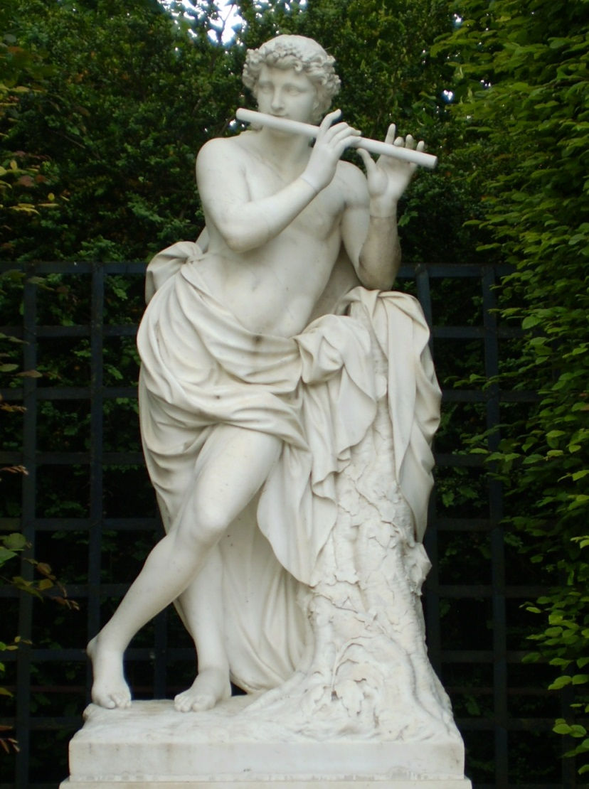
The Importance of Music Education
Developing one´s
  intellectual
  emotional
  social
  auditory
  imaginative
  qualities

Slide 6
Musical Development for Everyone
Offer options to suit everyone's needs
Not evaluate anyone
Be able to enthuse
Involve everyone according to their abilities
Everyone can develop and become enthusiastic about music

Slide 7
Neuroplasticity
A key characteristic of the brain - the need to constantly adapt, learn and evolve
Discovered in the second half of the 20th century (it didn't become more widely known until the late 20th century)
The brain's ability to change, form new connections and continually learn is made possible by the ability of neural tissue to change the configuration of neural connections - to form new connections between neurons, to myelinate, etc.
The process of new brain neuron formation (neurogenesis) - in adults only in the olfactory bulb and hypothalamus (Tardif et al., 2016).

Slide 8
Basic Neuroplasticity Conditions
Energy and nutrients - physical substrate - membrane and synapse composition, nutrients
Environmental factors - Presence of neurotransmitter acetylcholine, dopamine or other neurotrophic factors that are released under certain conditions and affect learning.
Motivation - Does what I am learning make sense to me, do I know what it will do for me?
Attention - Training attention „To be in the here and now" e.g. playing a musical instrument, singing or listening to music in a focused way.
Emotional experience - Presence of emotion = deeper memory traces creation.

Slide 9
The Effect of Music on People
Known clinical effects (heart rate, breathing, CNS effects, mood effects, activation/calming, etc.)
  Measurements by fMR, EEG, PET
Less known effects (artistic expression, action)
Unstudied effects (overlap of music into philosophy, perception of beauty, mystery ...)
Music is a higher revelation than all wisdom and philosophy."
(L. v Beethoven)

Slide 10
Evidence for Advantages of Music Learning
Science shows evidence of how music benefits the brain:
CAMERON, D. J., - GRAHN, J. A.: Neuroscientific investigations of musical rhythm. Acoustics Australia , 2014, vol. 42, no. 2, 111-116
HOEMBERG, V. – THAUT, M.: Handbook of Neurologic Music Therapy. Vol First edition. New York: OUP Oxford; 2014
KOELSCH, S. – SCHROGER, E. – TERVANIEMI, M.: Superior pre-attentive auditory processing in musicians. NeuroReport 1999;10: 1309-1313.
RODRIGUES, A. C. - LOUREIO, M. A. - CARAMELLI, P.: Musical training, neuroplasticity and cognition. Dement Neuropsychol. 2010 Oct-Dec;4(4):277-286.

Slide 11
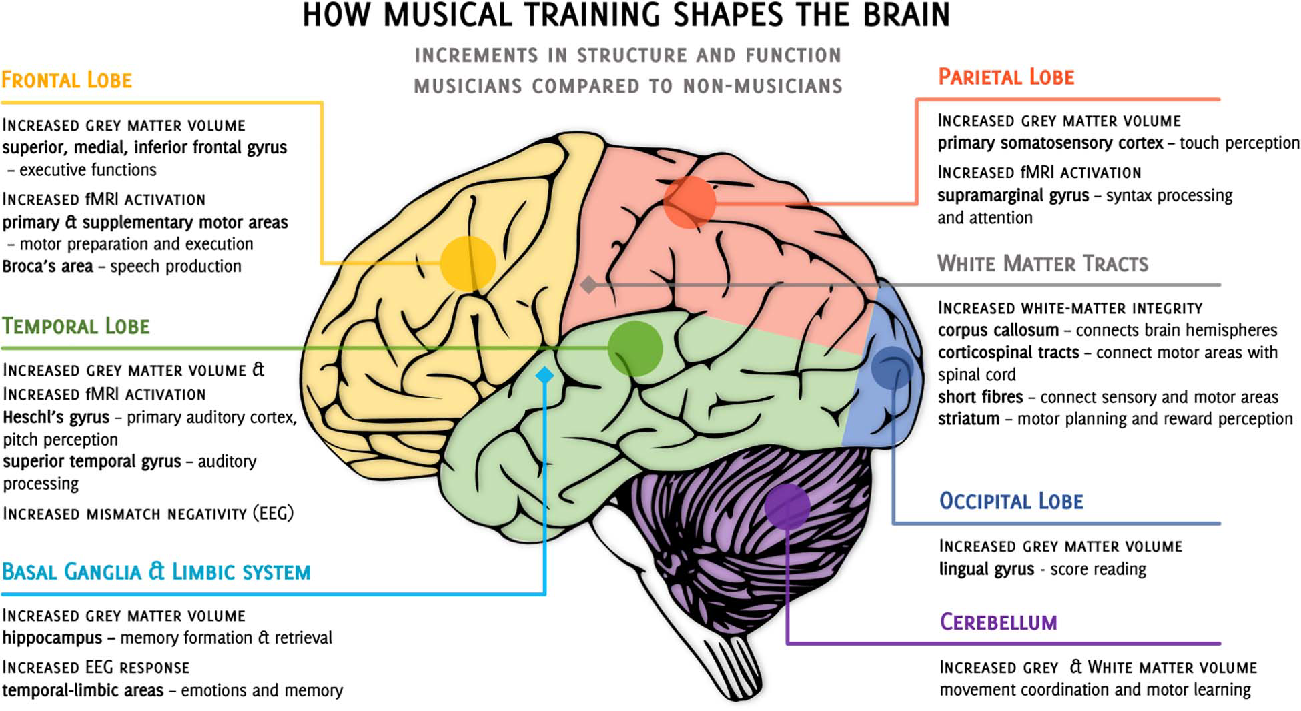
How The MT Shapes The Brain

Slide 12
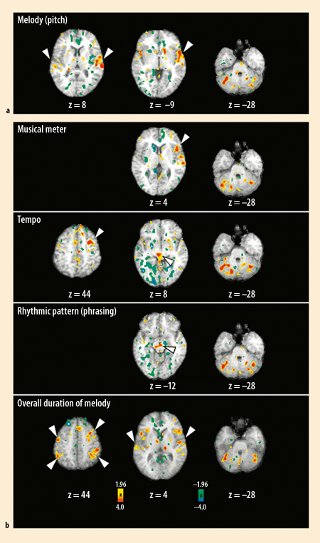
PET imaging of brain activity
Different activation of the brain centres during perception in change of
  rhythm ("note/dash")
  meter ("light/heavy note")
  tempo ("speed")
  melody ("pitch")
Michael H. Thaut Rythm, Music and the Brain, Routlege, NY 2008

Slide 13
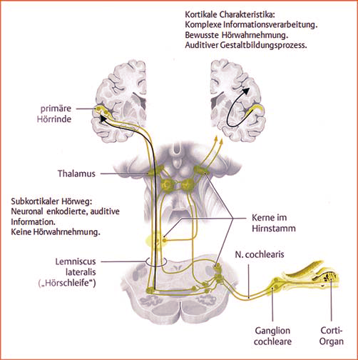
The Auditory Pathways
auditory perception
We percieve sounds
  subcortically
  cortically
The pathways change after brain injury (neuroplasticity)

Slide 14
The Term ‘Music Therapy’ …
MusicTherapy
  A therapeutic discipline that uses musical elements to work on specific therapeutic goals.
Music in a wider meaning
    (natural sounds, silence, rhythms, …)
Therapy (θεραπεία)
    (to accompany, to care, to cure, …)
Notes:
MT je terapeutická metoda, při které je hudba dominantní.

Slide 15
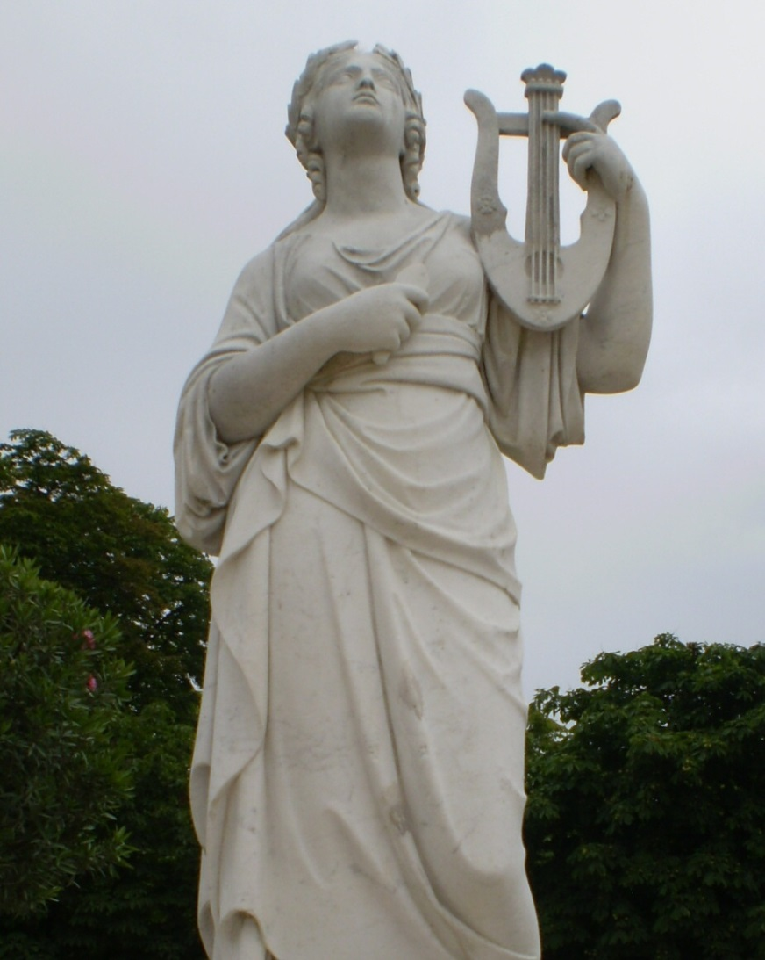
Music Therapy...
…uses music therapeutically to address
  physical
  psychological
  cognitive and
  social functioning
  for people of all ages.
… uses a powerful and non-invasive medium
  in which unique outcomes are possible

Slide 16
Music Therapy Around the World
WFMT (World Federation of Music Therapy)
  www.wfmt.info
EMTC (European Music Therapy Confederation)
  www.emtc-eu.com
CZMTA (Music Therapy Association of the Czech Republic)
  www.czmta.cz

Slide 17
Daily-Care Center Activities
Treatment of patients after Acquired Brain Injury (ABI)
Inter-disciplinary team
  Medicine (especially Neurology, Psychology)
  Physiotherapy
  Speech Therapy
  Occupational Therapy
  Special Education
  Music Therapy

Slide 18
Aims of MT at our Department
Improving the quality of movement
Involving hemiparetic limbs
Improving the quality of speech or non-verbal communication
Practicing cognitive functions
Practicing concentration and relaxation
Helping the person accept their condition and situation

Slide 19
Case Study - John X
55-year-old man
Suffered a craniocerebral injury in bike accident
No movement problems, but serious problems with communication, esp. aphasia
On FMR, significant lesions were found both in the Broca´s and the Wernicke´s areas
At the beginning of treatment there was no verbal communication at all (word salad)

Slide 20
Case Study - John X
MT as part of treatment
  improving general communication and auditory skills
  rhythmical exercises
  singing and playing musical instruments
  verbal and non-verbal communication skills

Slide 21
Case Study – Betty Y
17-year-old woman, student
Suffered an accident last summer – drowning, 15-minute resuscitation
No cognitive problems, but quite serious problems with movement, esp. dyskinesia and involuntary movements

Slide 22
Case Study – Betty Y
MT as part of treatment:
  functional use of her upper limbs playing musical instruments
  self-expression of her emotions
  verbal and non-verbal communication skills

Slide 23
Benefits of Music Education
Based on our clinical experience, we can confirm that most patients with previous musical activity show faster improvement
in ability indicators:
    Movement
    Cognitive skills
    Communication
    Social skills
    Integration back into society

Slide 24
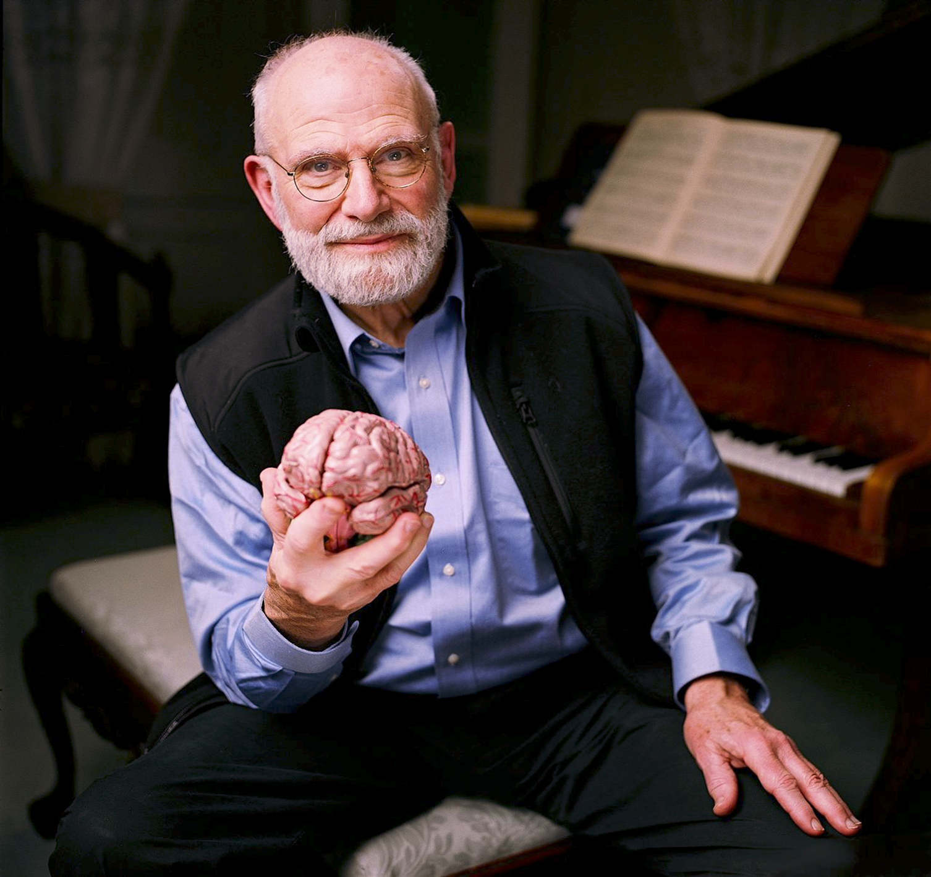
„The power of music to unite and heal... is immense... It is the most profound non-chemical healing." (Oliver Sacks, Awakenings)

Slide 25
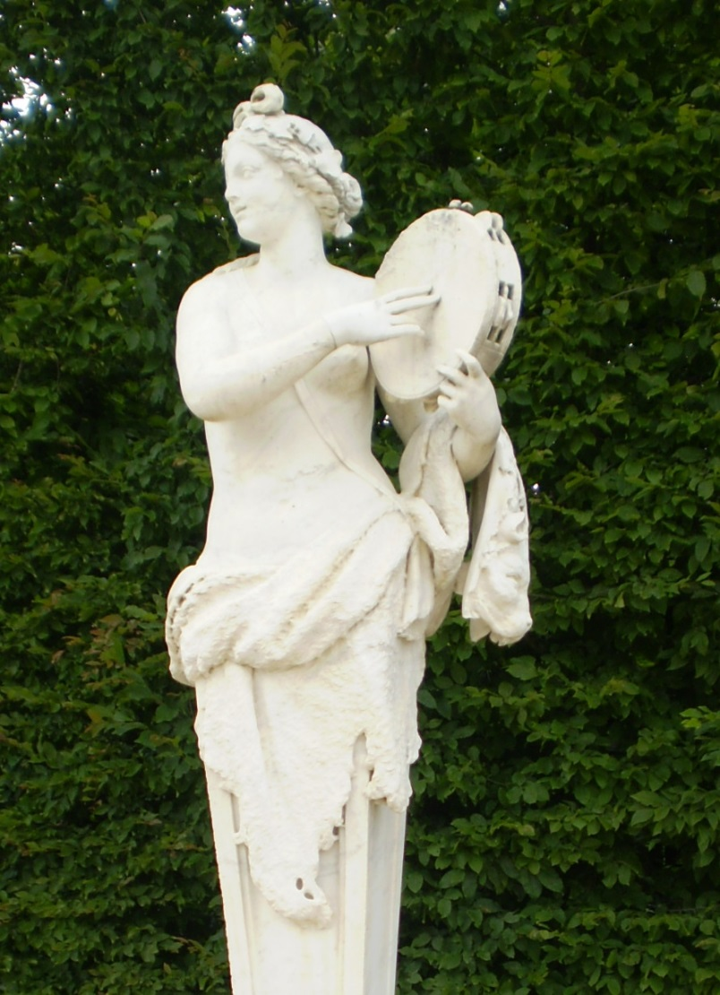
Thank you for your attention!
marketa.gerlichova@vfn.cz

