Slide 1
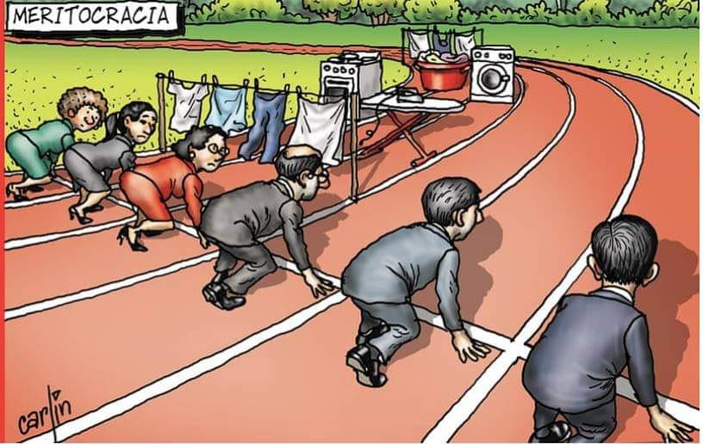
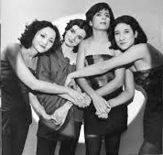
BEING A FEMALE (EA) COMPOSER (?)
PERFORMER, SOUD ENGINEER, MULTIMEDIA AND PERFORMING ARTS COMPOSER, PRODUCER, RESEARCHER, MANAGER, EDUCATOR, CURATOR, COMMERCIAL SOUND DESIGNER, JOURNALIST, SONGWRITER
MOTHER?
PARTNER?
?? Whatnot…ECOLOGY, PSYCHOLOGY, BIOLOGY, LINGUISTICS, MATH……more courses, masterclassess….
CONCENTRATION! TIME!

Slide 2

SOURCE OF INFORMATION
27 years of experience with participants in the international competition of sonic art MUSICA NOVA, www.musicanova.seah.cz (music and self-presentation).
Available CVs of other female composers (e.g.Audible Women, Donne in Musica)
Mail interviews with female composers
Output of the interviews with female leaders in CR
Statistics
Literature, articles…

Slide 3

CONTEXT
THEORETICAL ASSUMPTIONS
GENDER
CURRENT SHIFT MEANING AND POLITICAL DISCUSSION IN THE EU AND THE USA
GENDER = complex multilevel social and cultural construct.
Recommendation of APA (American Psychological Association) → not to be strictly fixed to the traditional gender stereotypes + be socially tolerant
BUT → different kind of understanding of this concept and following political practice in EU → → social engineering trends).
ARCHETYPES/ANIMA/ANIMUS/INDIVIDUATION (C.G.Jung)
Complex concept of human mind. These aspects can have good or inferior qualities of inner experience and behavior and different level of integration ( process of individuation).
Concept useful and used in ART analyses (e.g. J. J. Nattiez: Wagner androgyne).
Consequences → variety of inner balance of man/woman aspects of psyche embodied into the art work.
Correspondence to the variations of feminism.

Slide 4
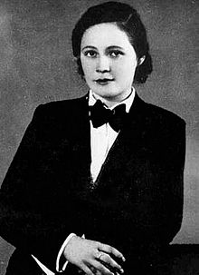
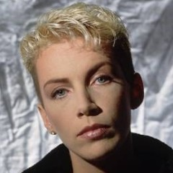
VARIANTS OF FEMINISM
HISTORY AND PRESENT
MASCULINE FEMINISM: woman with MASCULINE LOOK (and some masculine signs of behaviour)
Vítězslava Kaprálová Annie Lennox

Slide 5
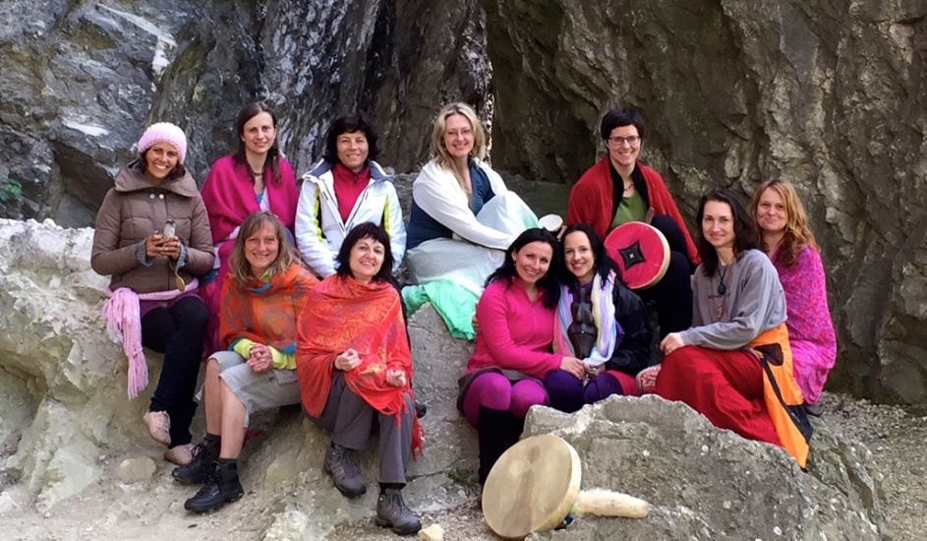
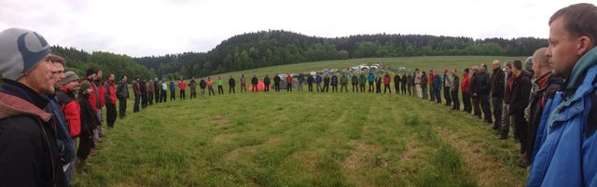
VARIANTS OF FEMINISM and MASCULINISM (?)
SACRED FEMININITY
many smaller female circles
fewer bigger male cirles ☺
male circle in CR

Slide 6
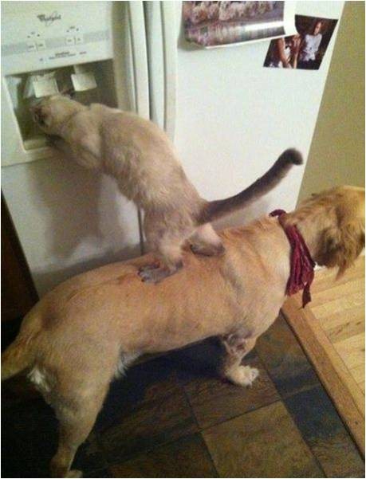
WELL-BALANCED VARIANT
Well balanced „male“/“female“
„parts“ of mind (C.G.JUNG)
→ individuation
→ cooperation
→ tolerance

Slide 7
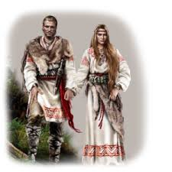
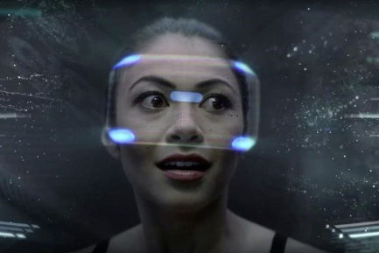
OR the trend of break?
people searching for roots of
femininity and masculinity, their
traditional roles
young generation of people dependent
on technologies used their vital energy
for maintaining more virtual
(gender, trans-, supra-) identities in social networks
and virtual plays.

Slide 8
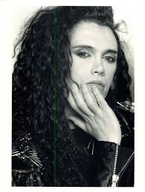
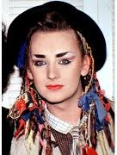

GENDER IN GLOBAL POP MUSIC
Gender play/relativisation in current global pop music. Opportunities for all gender groups (61.6% women in USA 2012-18).
https://www.statista.com/statistics/801266/gender-distribution-popular-songs-genre/
Gavin Lee: Rethinking Difference in Gender, Sexuality and Popular Music: Theory and Politics of Ambiguity, 1st. Ed. 2018 Routledge.
Peter Burns Boy George Bilal Hassani – new prodigy in France

Slide 9
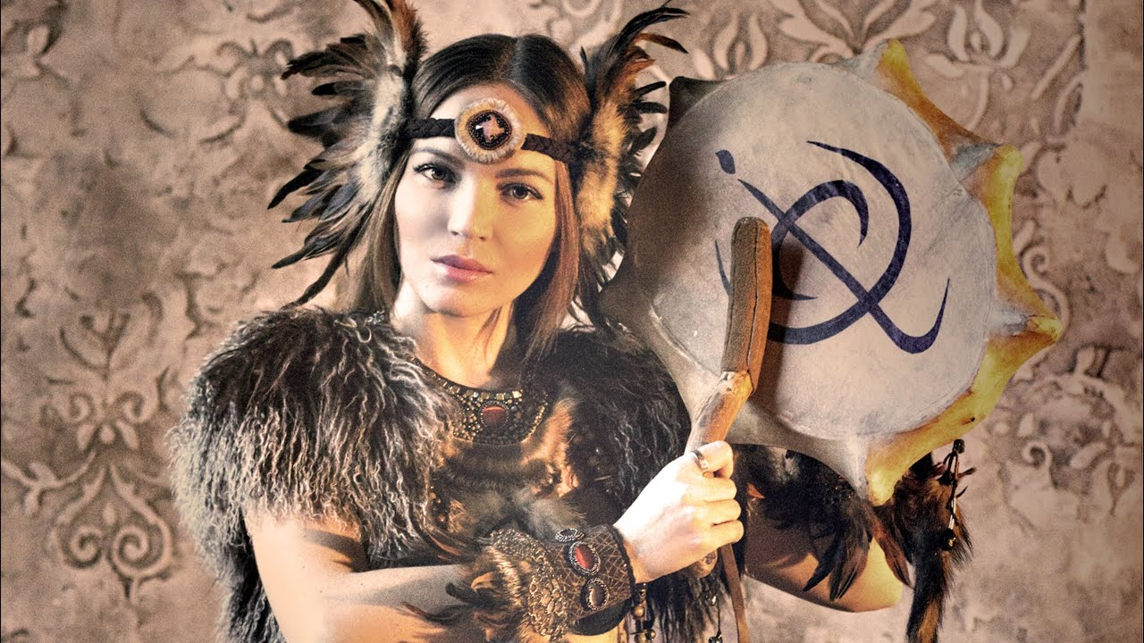
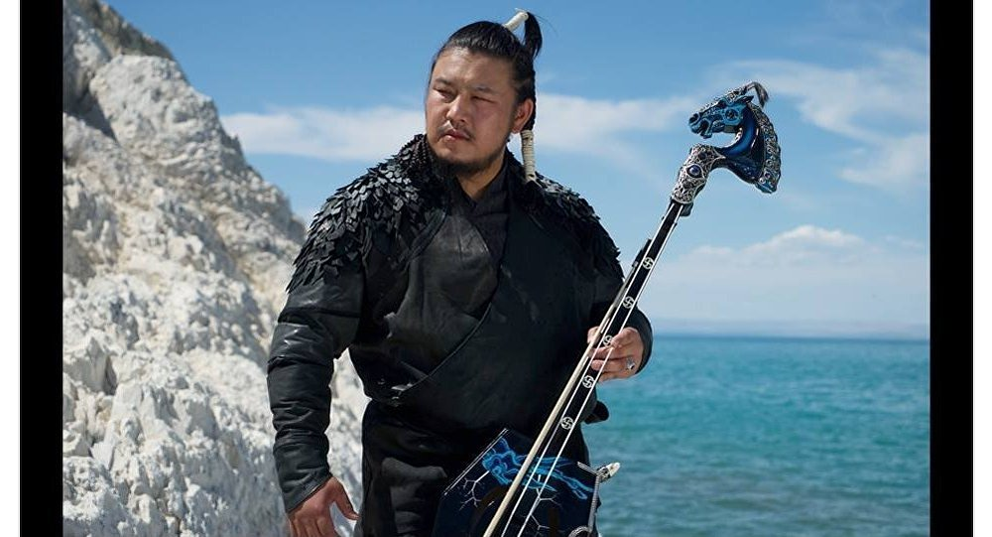
GENDER IN WORLD/TRADITIONAL FOLK MUSIC
Traditional gender archetypes
Olena UUTAi – Siberian female shaman The HU (Mongolian world music)

Slide 10

TRADITIONAL FOLK MUSIC

Slide 11
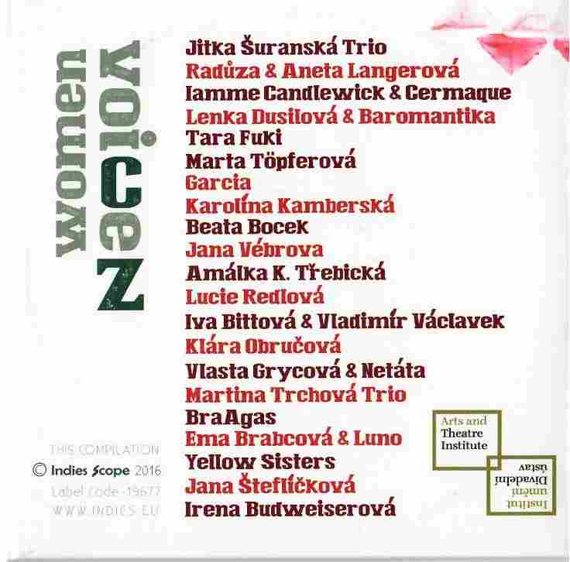
CZECH WORLD WOMEN VOICES

Slide 12
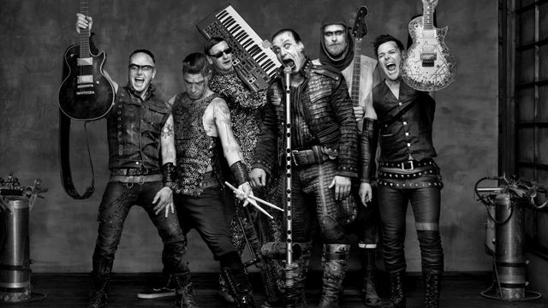
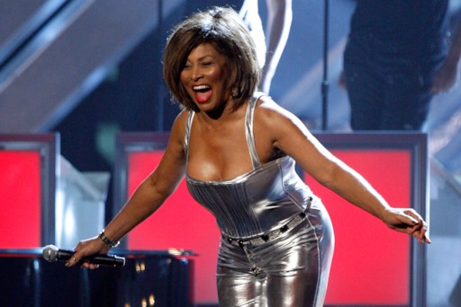
GENDER IN ROCK
MODERNISM/TECHNOLOGIES–
limit provocative image of masculinity/femininity
Rammstein Tina Turner

Slide 13
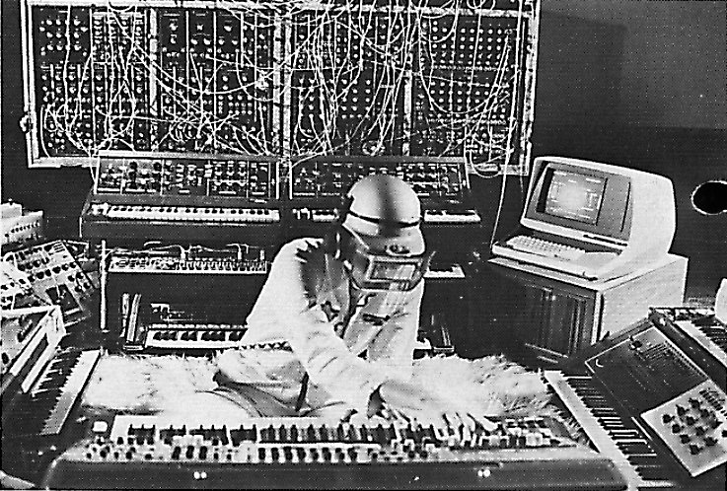
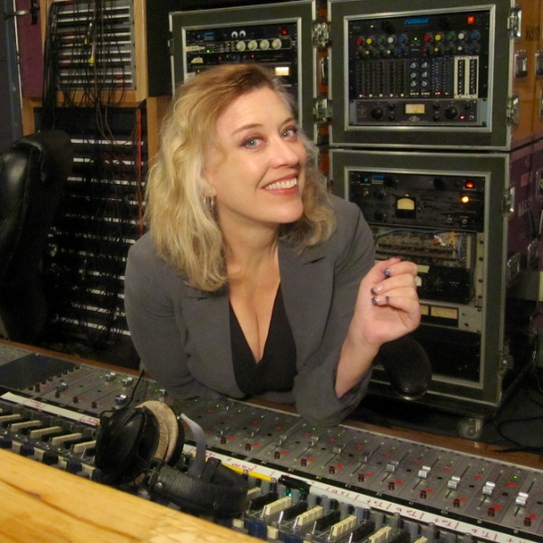
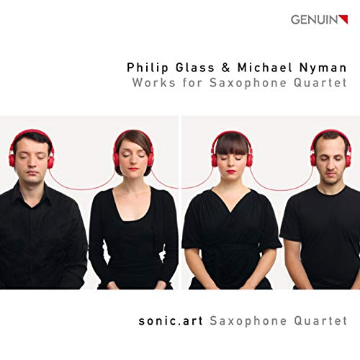
ELECTRO-ACOUSTIC MUSIC
SONIC /SOUD ART…
EVOLUTION OF TRENDS
from technical (masculine) modernity to full spectrum…

Slide 14
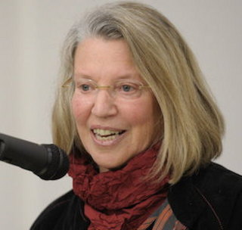
DISCRIMINATION?
Dr. Nancy FRASER (*1947, USA, APA)
„For me, feminism is not simply a matter
of getting a smattering of individual women into
positions of power and privilege within
existing social hierarchies. It is rather about
overcoming those hierarchies..“
Two kind of justice/injustice:
a) distributive justice b) justice of recognition

Slide 15
DISTRIBUTIVE INJUSTICE IN GENDER
Access to job vacancies or project opportunities
Salaries, financial rewards
what is the leading agens?
traditional stereotype?
gender bias?
e.g. Czech Republic: LPN (licenced practical nurse) – women median of salaries men:women – 83:100%
in showbusiness women receive up to 50% more than men…
HYPOTHESIS:
People are more influenced by the habitual practice than by chauvinism. If the practice changes, the people are able to adapt continuously.

Slide 16
ACTUAL SITUATION IN DISTRIBUTIVE GENDER INJUSTICE
Morgan Stanley report, "more gender diversity, particularly in corporate settings, can translate to increased productivity, greater innovation, better products, better decision-making, and higher employee retention and satisfaction.“
REALITY: percentage of women in the top management:
EU 25%, global world 13%, CR 9% (BUT the score of graduates in management studies at univerisites in the CR makes ca 70/30 women/men)
REALITY in the CR
CR – Antidiscrimination Act No. 198/2009 Coll.
BUT
the difference between salaries men/women up to 22 %, in the segment of management about 13 %
44 % of women testify the financial discrimination (including the top positions) in the CR
(source: Qualitative research No. 1032, collection of data: April 2017)

Slide 17

Methodology of this score?
We need the more deeper analyse of the methodology.
Questions:
What are the reasons of lower salaries /incomes of women?
? the statistics compare contractual incomes or real incomes decreased by the time devoted to the family /children care?

Slide 18
MUSIC – STATISTICS Donne in Musica
Only 76 classical concerts among 1,445 performed across the world in the year 2018 included at least on piece by a woman. Total of 3,524 works performed at those concerts included only 82 works written by women.
(source Mark Brown: „Female Composers Largely Ignored by Concert Line-ups“, The Guardian, 13.6.2018)
In Sweden and Norway increased the percentage
to 40 % (source: European Composer and Songwriter Alliance, president Alfons Karabuda)
Hollwood films – women make up 6 % of composers (source: Z. Nathoo, CBC News, 26.1.2019)

Slide 19
COPYRIGHT SOCIETY
SACEM – 9% female composers, 3% female conductors, 12% female managers.
Czech Copyright Society (OSA)
- CCS represents 5857 Czech living authors, out of which there are 960 female authors (pop + classical music)
- with „status of member“ of the Society:
503 living authors, out of which there are 30 female authors.
NOTE: limit for membership: 80,000 CZK/year (gross income) in pop, 40,000 CZK in classical music
i.e. 3,200 EUR/1,600 EUR!

Slide 20
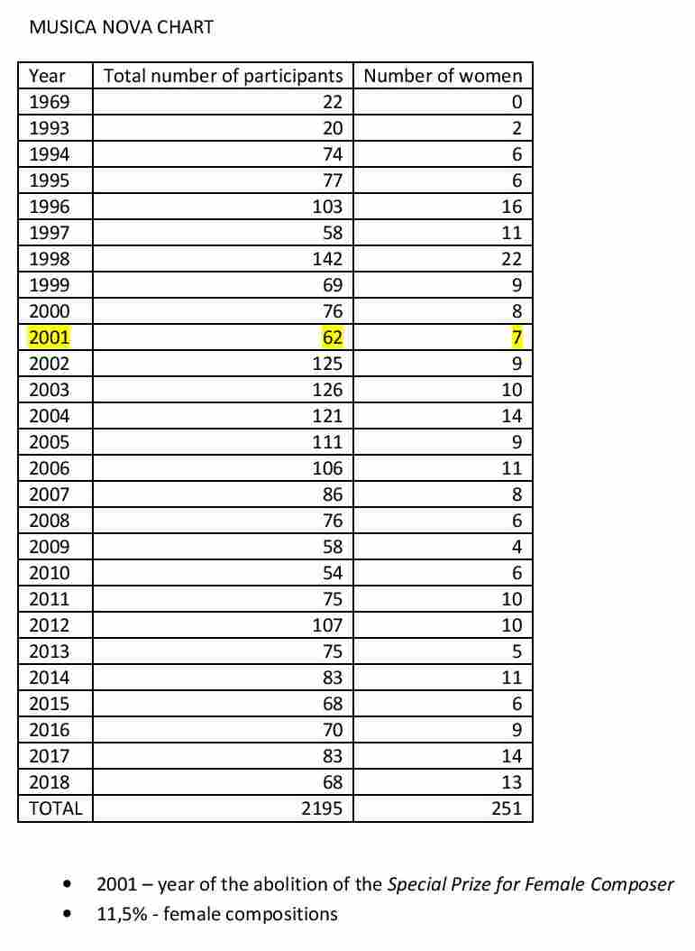
MUSICA NOVA STATISTICS

Slide 21
MUSICA NOVA – NUMBER OF PARTICIPANTS

Slide 22
SCREENING OF SELF-IMAGES
99 CVs and personal aestethics from MUSICA NOVA
(more frequent women-participants:
Edith Alonso, Elizabeth Anderson, Natasha Barrett, Eliška Cílková, Rose Dodd, Chin Chin Chen, Koyng Mee Choi, Elizabeth Hoffman, Tereza Hron, Louise Rossiter, Diana Salazar, Marilinda Santi, Pei-Yu Shi, Kotoka Suzuki, Anette Vande Gorne…)
+ 61 CVs at www.audiblewomen.com SECTION - ELECTROACOUSTIC
Control group:
160 male composers CVs and personal aesthetics from MUSICA NOVA
(more frequent male composers/participants:
David Berezan, Jason Bolte, Bernard Clarc, Gilles Gobeil, Phivos Angelos Kolias, Mario Mary, Daniel Mayer, Robert Normandeau, Joao P. Oliveira, Felipe Otondo, Michal Rataj, Antonio Scarcia, Adam Stanovic, Clemens von Reusner, R. S. Thompson, John Young, Yu Chung Tseng….)

Slide 23

some conclusions…
Women underline their education and training in many branches and disciplines
(it corresponds with their fears of financial stability described in interviews and the prevailing project practice).
2) Women in their personal aesthetics express often interested in (sound)ecology, deeper meaning in divergent materials and ideas, connecting qualities of language, body and music, active working with public and performers and precise transfer of their intentions and feelings to public…

Slide 24
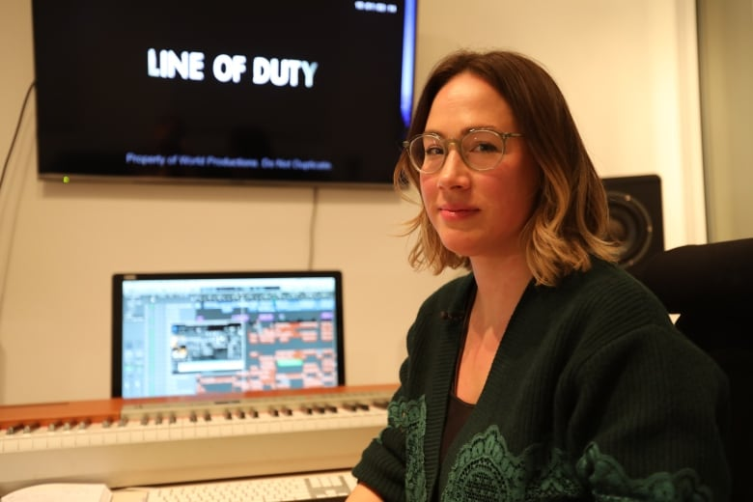
INTERVIEWS
Interviews sent by mail to 54 female authors:
Questions (inspired by a similar research abroad)
e.g. D. C. Sergeant, E. Himonides: Gender and Music Composition: A Study Music, and the Genderin of Meanings
D. Bennett, S. Macarthur, C. Hope, T. Goh: Creating a Carrer as a Woman composer, in Britihs Journal of Music Education 11/2018, pp. 237-253
photo: Carly Paradis, Canada
Received answers from 23 female authors
(from Argentina, Austria, Australia, Belgium, Czech Republic, France, GB, Italy, Japan, Kanada, Russia, Spain, Sweden, USA)

Slide 25

QUESTIONS…
Do you think it is possible to identify sex or gender of the composer from the musical style/content of a composition?
Do you think (or do you admit some kind of connotations) that musical sounds, or the organization of sounds within a composition, infer sex or gender characteristics? (e.g. properties faster tempi, stressed/dramatic expression, controlled/quasi objective..etc. as a symbols of maleness; slower tempi, lighter texture, mild/submissive, sensitive/emotional, calm/reflective etc. as a symbols of femaleness?
example of link: J. J. Nattiez: Wagner Androgyne, Paris 1990
note: These hypotheses were tested in research documented in the study „Gender and Music Composition“ by D. S. Sergeant and E. Himonides)

Slide 26

ANSWERS
Ad 1)
only 1 person (CR) answered that she is obviously able to identify female sex of the composer, but she does not know HOW, it is not so simple how it is presented it the hypothesis (it is more intuitive and complex understanding)
Women rather expressed some resistance to this kind of thinking, they called it „old school thinking“.

Slide 27
ANSWERS
Ad 2)
Only 5 people (from Argentine, Australia, CR, France, Italy) answered that it could be useful to focus on it, that gender archetypes could help in program, dramatic, dance, movie music (and maybe they are used it some way), but they have not enough information to do it..
The majority of women answered that they work in more general way (with contrast of darkness/lightness, density, aggression/passivity etc.) and do not like this kind of thinking.

Slide 28

CONCLUSIONS
The majority of women do not like to
project or analyse their music by a gender „filter.“
For them it is an expression of sexism.
Interesting:
We can see visible difference in comparison with traditional folk, world music, pop, visual art and literature where gender/sex aspects play an important semantic role.

Slide 29
QUESTIONS - DISCRIMINATION
Ad 3) All women noticed some kind of discrimination especially the variant of access to better job opportunities and especially the credibility injustice.
Ad 4) All women confirmed that „having a baby“ requires supporting family but the professional background expects complications.

Slide 30
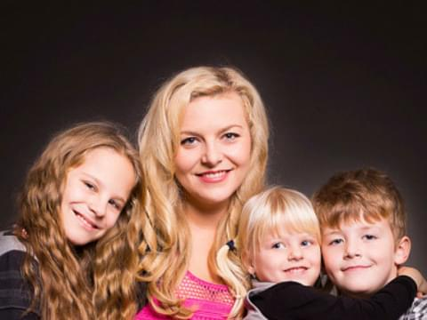
INTERESTING REMARKS
OF FEMALE LEADERS
Never is „optimal time“ to start…
I believe in principle of higher good
The cooperation is not anything evident
If you feel not good, it is the only feeling
You need not be perfect!
Find your individuality!
Photo: Simona Kijonková – Zásilkovna (cargo service)

Slide 31
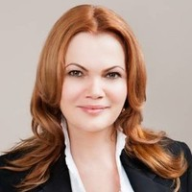
SELF CRITICISM
How to find the respect of men? Behave naturally!
I rather have the experience with some resistance and psychological blocks by women (as a consequence of their higher uncertainty, or worse self-confidence)
We are often not able to separate work and personal life
Women in the leadership do not automatically guarantee soft skills (wrong exhibition of female animus – like sharp, inflexible, power-hungry person – ref. to JUNG)
Photo: Karolina Topolová – AAA auto

Slide 32
MEN´S PRAISE
Women are more solid
Women often prefer a more complete life (especially during their „middle age“) and decide to leave their top special career (P. Jordan)
Women know better than men work under inconvenient conditions.

Slide 33

RECOMMENDATIONS level of consensus
Gender quota – not too popular, but acceptable for some time as a social test…NO/YES
Recommendations to include more female repertoire, leadership (to receive public money), better PR i.e. contact female composers communities etc. - YES
Selection of repertoire or awarded compositions at random, i.e. without names and age (as the 1st round) YES

Slide 34
RECOMMENDATIONS II
Gender mixed juries of competitions and committee YES
Special festivals, competitions, awards for women, 60:40 YES/NO
Special methodologies of education for women (examples from IT branches)
Self-help communities (webs) for increase the possibilities of natural contacts and shared opportunities YES
Better additional service for women YES
Discussion, research YES

Slide 35


Contact:
Lenka Dohnalová
lenka.dohnalova@idu.cz
www.chr-cmc.org
www.musicanova.seah.cz

